Slide 1
Vector
Fndt'n of IS & Data Anlys

Slide 2
Contents
Vectors
Vector addition
Scalar-vector multiplication
Inner product, Norm, Distance
Linear functions
Applications: Regression and Clustering
Linear independent
Basis
Orthogonal and Orthonormal

Slide 3
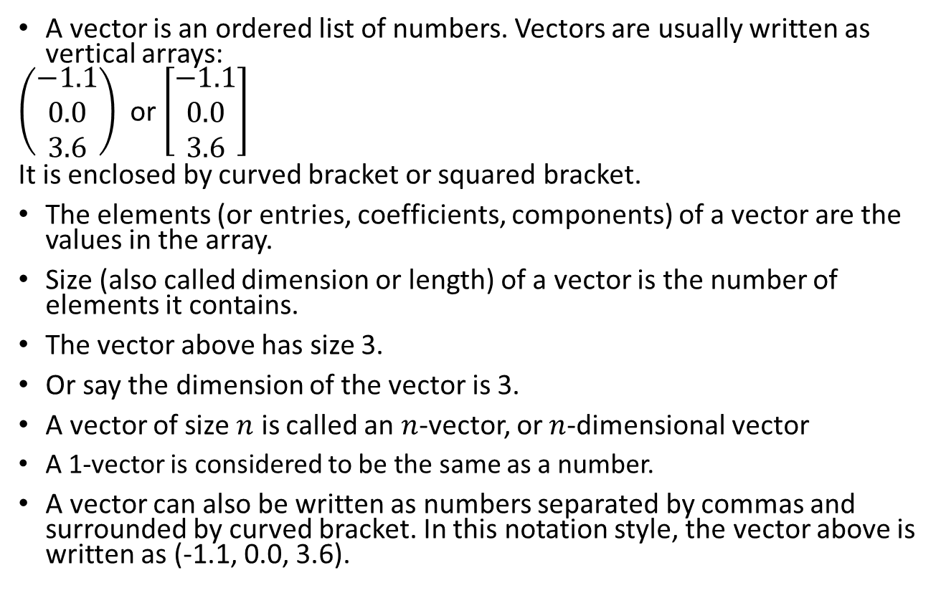
What is vector?
A vector is an ordered list of numbers. Vectors are usually written as vertical arrays:
$\left(\begin{matrix}−1.1 \\ 0.0 \\ 3.6\end{matrix}\right)$ or $\left[\begin{matrix}−1.1 \\ 0.0 \\ 3.6\end{matrix}\right]$
It is enclosed by curved bracket or squared bracket.
The elements (or entries, coefficients, components) of a vector are the values in the array.
Size (also called dimension or length) of a vector is the number of elements it contains.
The vector above has size 3.
Or say the dimension of the vector is 3.
A vector of size $n$ is called an $n$-vector, or $n$-dimensional vector
A 1-vector is considered to be the same as a number.
A vector can also be written as numbers separated by commas and surrounded by curved bracket. In this notation style, the vector above is written as (-1.1, 0.0, 3.6).
In advanced concept, a vector may contain infinite elements

Slide 4
What is vector?
CAUTION
DO NOT USE your high school notation to represent a vector
YOU CANNOT use
the so-called i j k notation to represent a vector in this course.
I do not mark the answers with such notations

Slide 5
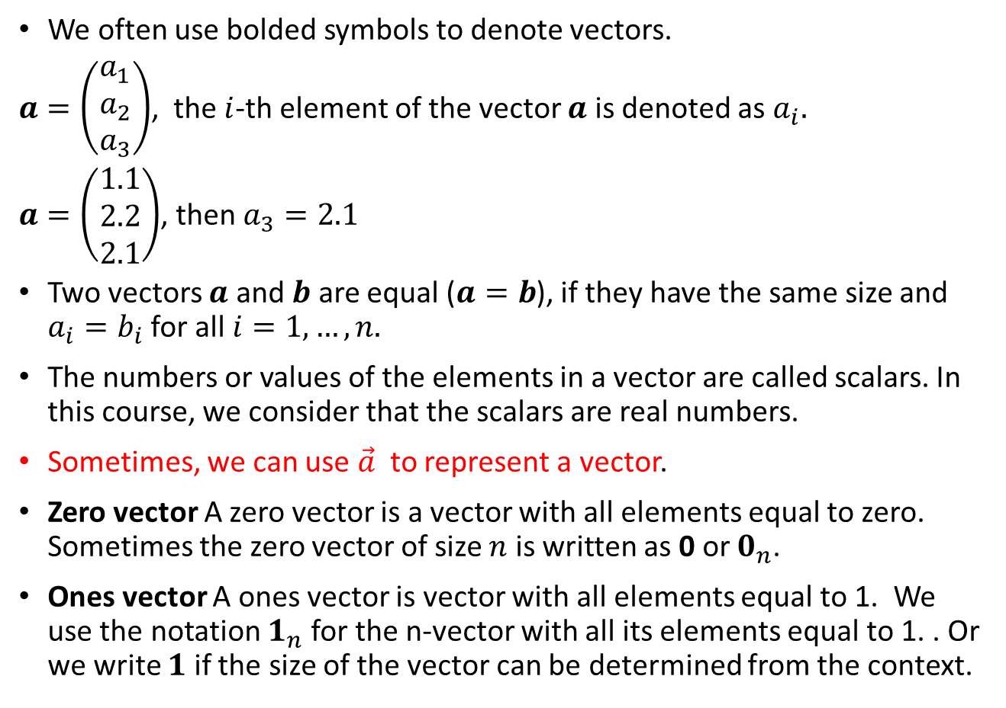
Vector notation
We often use bolded symbols to denote vectors.
$a=\left(\begin{matrix}a_{1} \\ a_{2} \\ a_{3}\end{matrix}\right)$, the $i$-th element of the vector $a$ is denoted as $a_{i}.$
$a=\left(\begin{matrix}1.1 \\ 2.2 \\ 2.1\end{matrix}\right)$, then $a_{3}=2.1$
Two vectors $a$ and $b$ are equal ($a=b$), if they have the same size and $a_{i}=b_{i}$ for all $i=1, …,n.$
The numbers or values of the elements in a vector are called scalars. In this course, we consider that the scalars are real numbers.
Sometimes, we can use $\vec{a}$ to represent a vector.
Zero vector A zero vector is a vector with all elements equal to zero. Sometimes the zero vector of size $n$ is written as 0 or $0_{n}$.
Ones vector A ones vector is vector with all elements equal to 1. We use the notation $1_{n}$ for the n-vector with all its elements equal to 1. . Or we write $1$ if the size of the vector can be determined from the context.

Slide 6
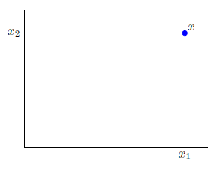
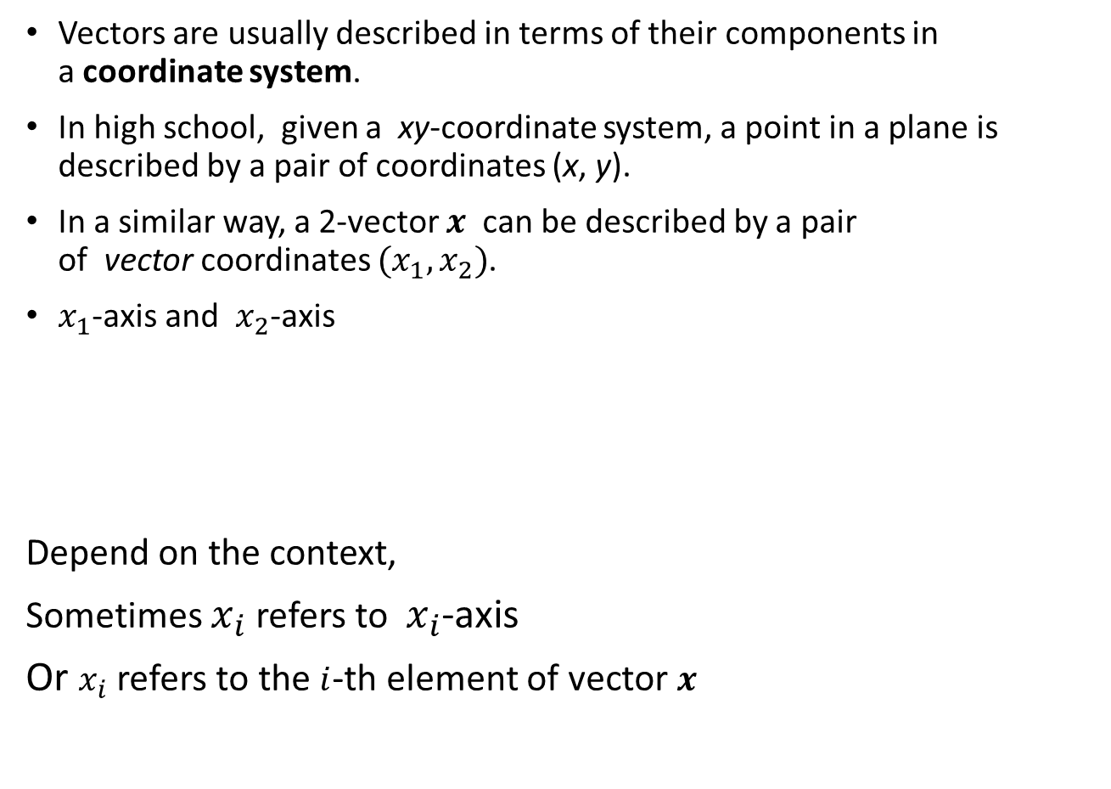
Vector notation
Vectors are usually described in terms of their components in a coordinate system.
In high school, given a xy-coordinate system, a point in a plane is described by a pair of coordinates (x, y).
In a similar way, a 2-vector $x$ can be described by a pair of vector coordinates $(x_{1},x_{2})$.
$x_{1}$-axis and $x_{2}$-axis
Depend on the context,
Sometimes $x_{i}$ refers to $x_{i}$-axis
Or $x_{i}$ refers to the $i$-th element of vector $x$

Slide 7
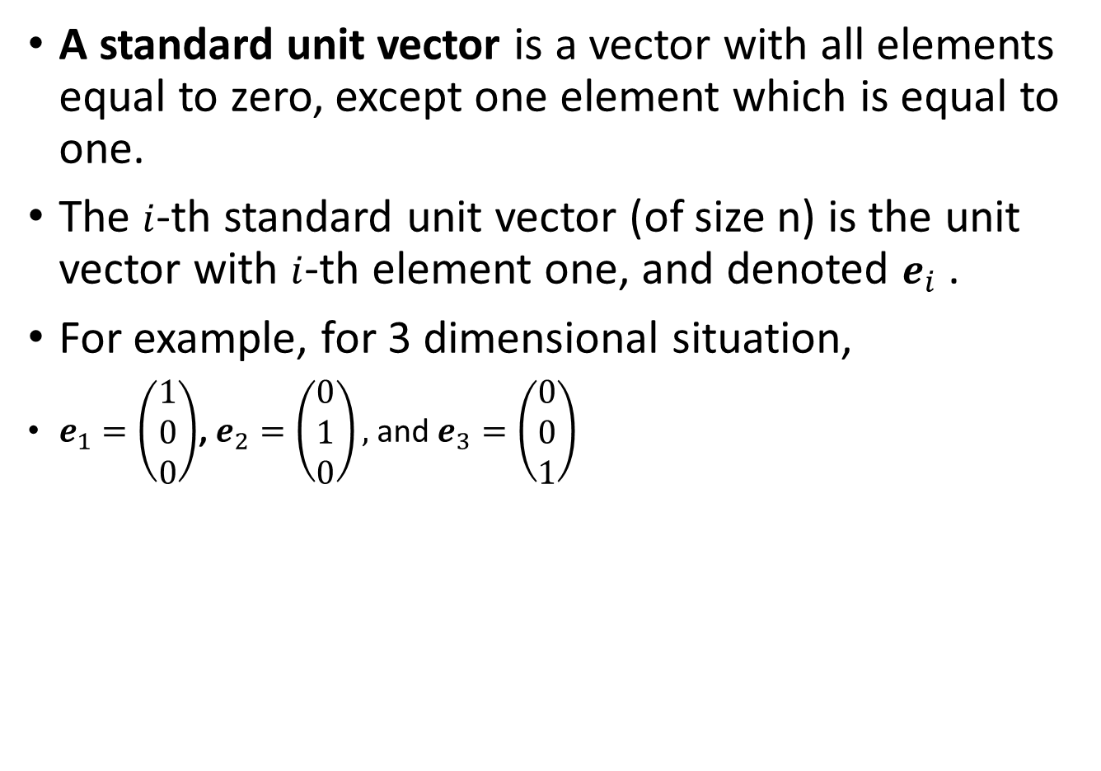
Vector notation
A standard unit vector is a vector with all elements equal to zero, except one element which is equal to one.
The $i$-th standard unit vector (of size n) is the unit vector with $i$-th element one, and denoted $e_{i}$ .
For example, for 3 dimensional situation,
$e_{1}=\left(\begin{matrix}1 \\ 0 \\ 0\end{matrix}\right)$, $e_{2}=\left(\begin{matrix}0 \\ 1 \\ 0\end{matrix}\right),$ and $e_{3}=\left(\begin{matrix}0 \\ 0 \\ 1\end{matrix}\right)$

Slide 8
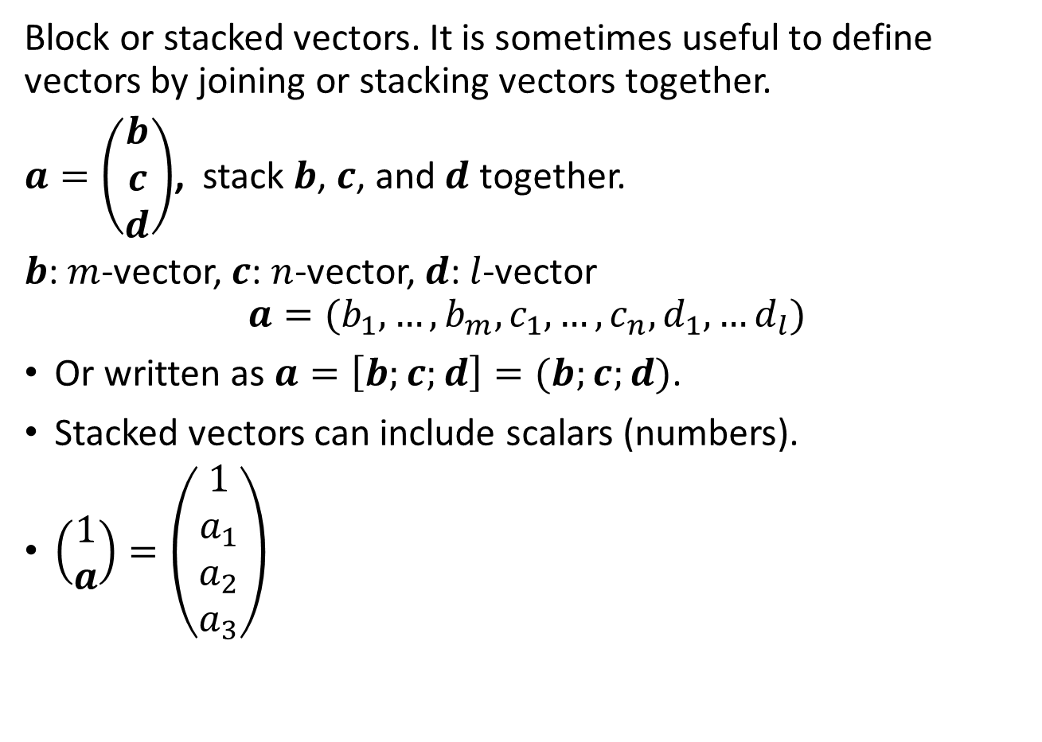
Other notations (may be useful in senior year courses)
Block or stacked vectors. It is sometimes useful to define vectors by joining or stacking vectors together.
$a=\left(\begin{matrix}b \\ c \\ d\end{matrix}\right)$, stack $b$, $c$, and $d$ together.
$b$: $m$-vector, $c$: $n$-vector, $d$: $l$-vector
$$a=(b_{1},…,b_{m},c_{1},…,c_{n},d_{1},…d_{l})$$
Or written as $a=\left[b;c;d\right]=(b;c;d)$.
Stacked vectors can include scalars (numbers).
$\left(\begin{matrix}1 \\ a\end{matrix}\right)=\left(\begin{matrix}1 \\ a_{1} \\ a_{2} \\ a_{3}\end{matrix}\right)$

Slide 9
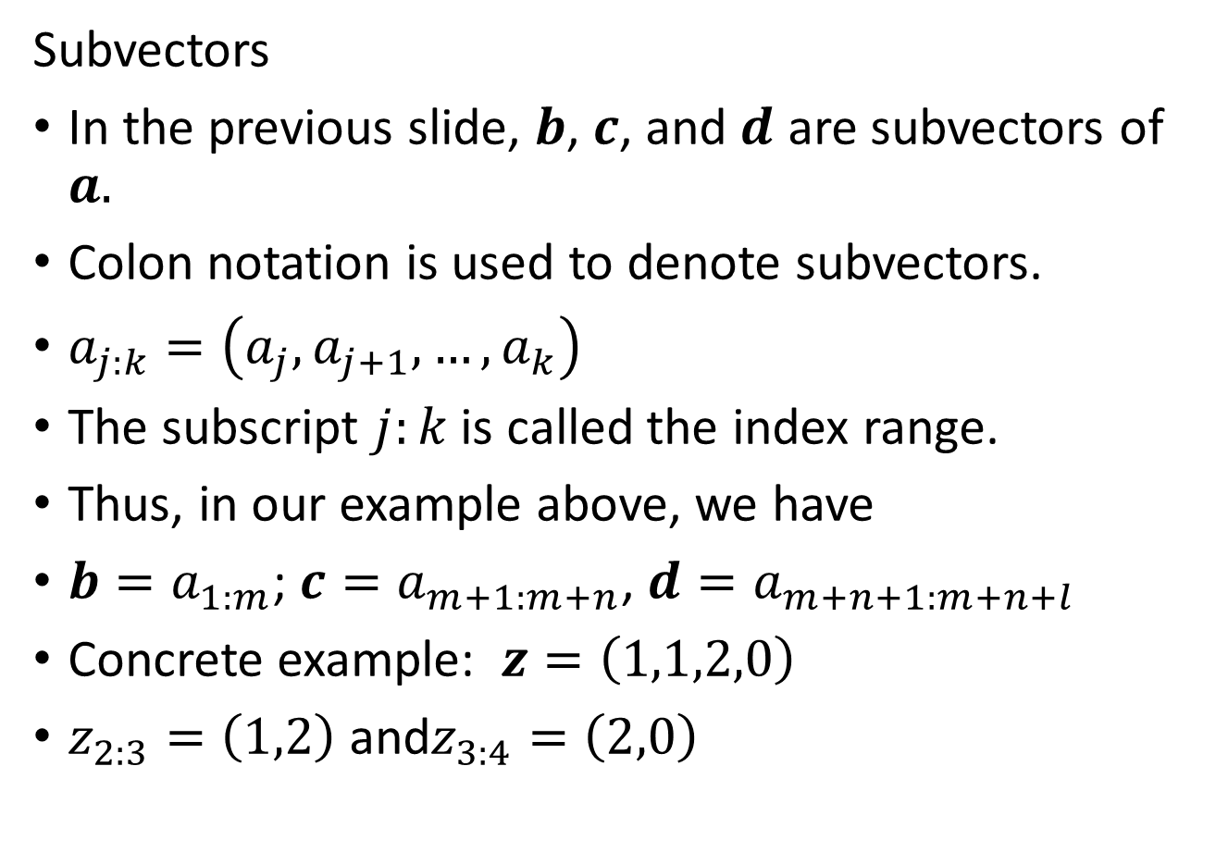
Other notations (may be useful in senior year courses)
Subvectors
In the previous slide, $b$, $c$, and $d$ are subvectors of $a.$
Colon notation is used to denote subvectors.
$a_{j:k}=\left(a_{j},a_{j+1},…,a_{k}\right)$
The subscript $j:k$ is called the index range.
Thus, in our example above, we have
${b=a}_{1:m}$; ${c=a}_{m+1:m+n}$, ${d=a}_{m+n+1:m+n+l}$
Concrete example: $z=\left(1,1,2,0\right)$
$z_{2:3}=\left(1,2\right)$ and$z_{3:4}=\left(2,0\right)$

Slide 10
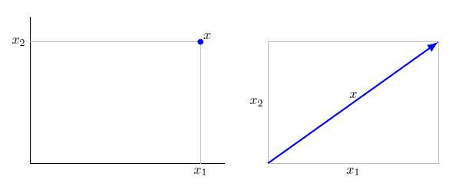
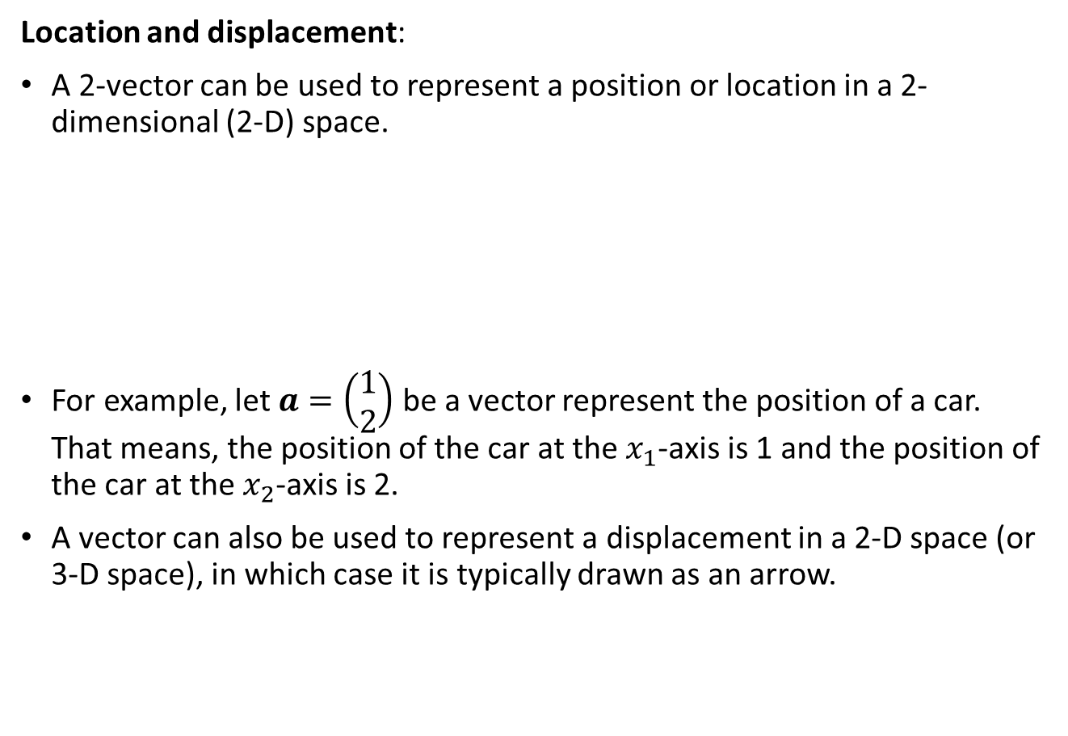
Representation our real world data using vector
Location and displacement:
A 2-vector can be used to represent a position or location in a 2-dimensional (2-D) space.
For example, let $a=\left(\begin{matrix}1 \\ 2\end{matrix}\right)$ be a vector represent the position of a car. That means, the position of the car at the $x_{1}$-axis is 1 and the position of the car at the $x_{2}$-axis is 2.
A vector can also be used to represent a displacement in a 2-D space (or 3-D space), in which case it is typically drawn as an arrow.

Slide 11
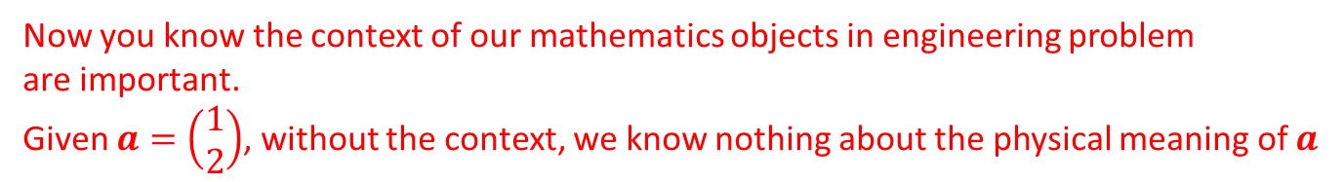
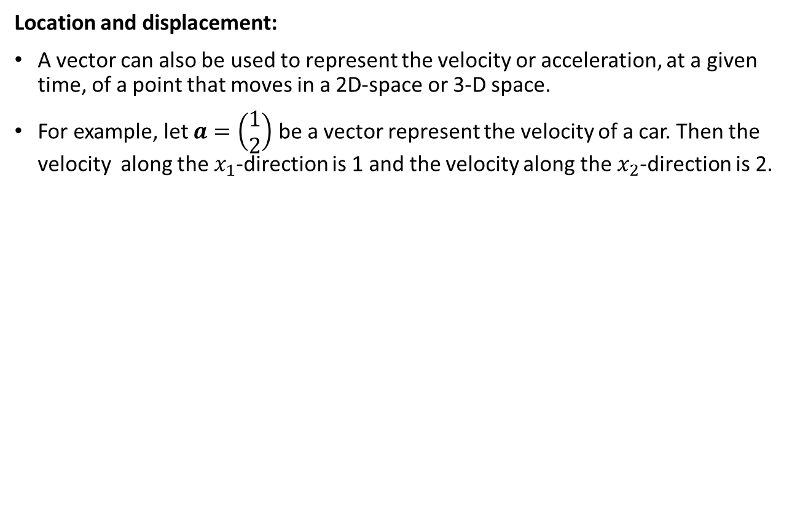
Representation our real world data using vector
Location and displacement:
A vector can also be used to represent the velocity or acceleration, at a given time, of a point that moves in a 2D-space or 3-D space.
For example, let $a=\left(\begin{matrix}1 \\ 2\end{matrix}\right)$ be a vector represent the velocity of a car. Then the velocity along the $x_{1}$-direction is 1 and the velocity along the $x_{2}$-direction is 2.
Now you know the context of our mathematics objects in engineering problem
are important.
Given $a=\left(\begin{matrix}1 \\ 2\end{matrix}\right)$, without the context, we know nothing about the physical meaning of $a$

Slide 12
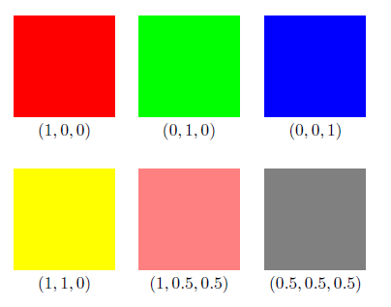
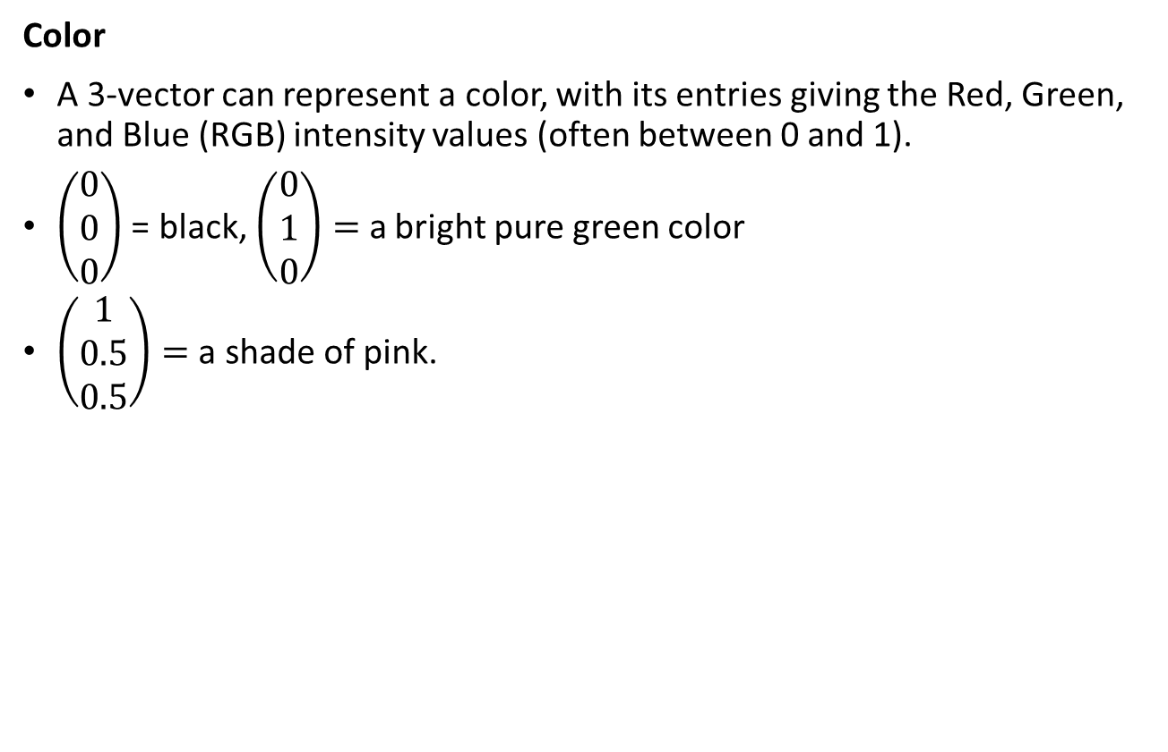
Representation our real world data using vector
Color
A 3-vector can represent a color, with its entries giving the Red, Green, and Blue (RGB) intensity values (often between 0 and 1).
$\left(\begin{matrix}0 \\ 0 \\ 0\end{matrix}\right)$ = black, $\left(\begin{matrix}0 \\ 1 \\ 0\end{matrix}\right)=$ a bright pure green color
$\left(\begin{matrix}1 \\ 0.5 \\ 0.5\end{matrix}\right)=$ a shade of pink.

Slide 13
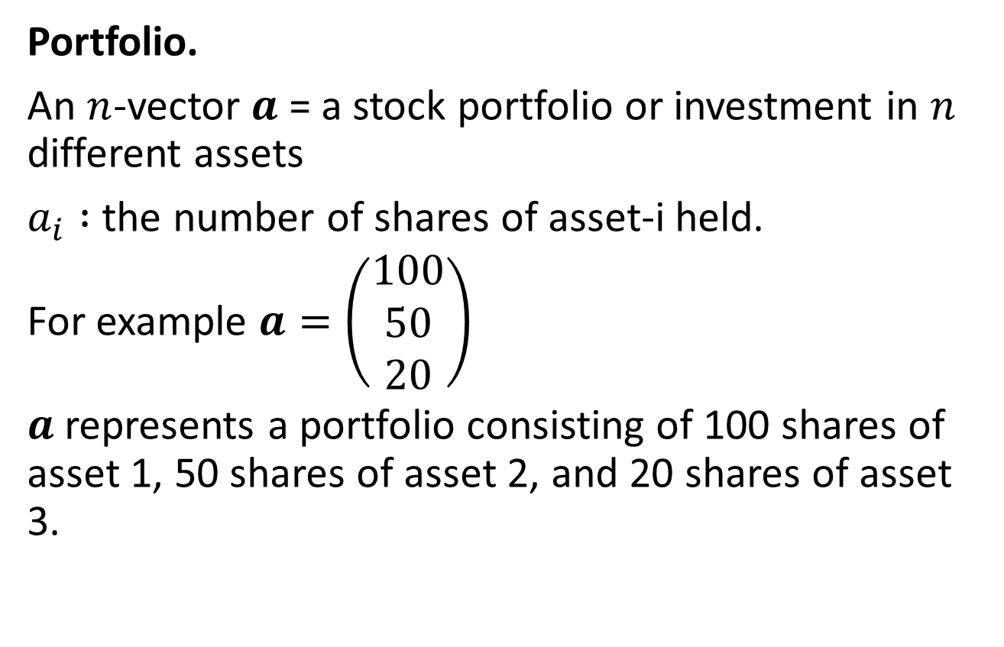
Representation our real world data using vector
Portfolio.
An $n$-vector $a$ = a stock portfolio or investment in $n$ different assets
$a_{i} :$ the number of shares of asset-i held.
For example $a=\left(\begin{matrix}100 \\ 50 \\ 20\end{matrix}\right)$
$a$ represents a portfolio consisting of 100 shares of asset 1, 50 shares of asset 2, and 20 shares of asset 3.

Slide 14
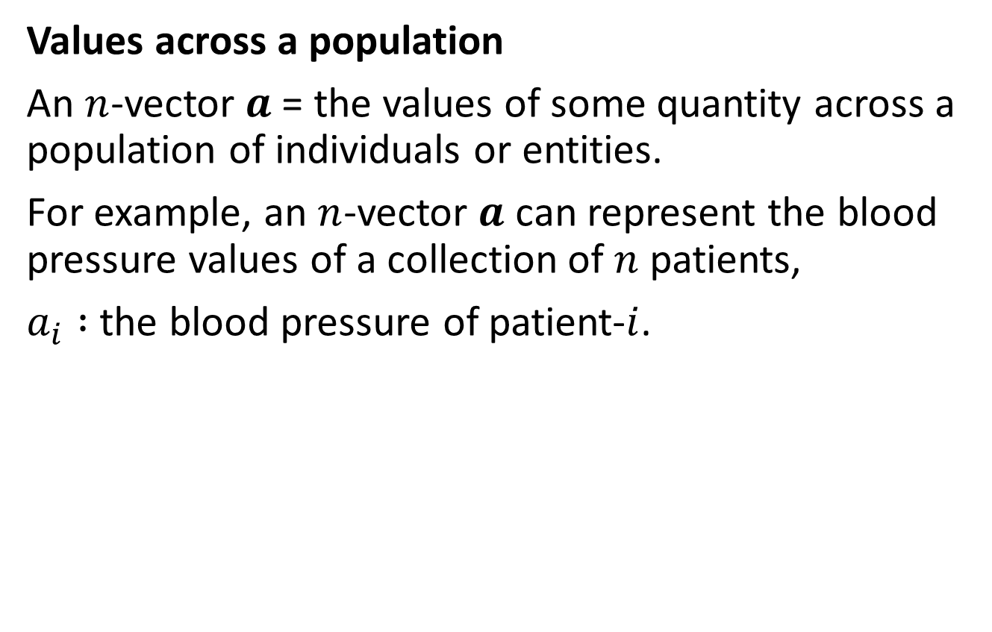
Representation our real world data using vectors
Values across a population
An $n$-vector $a$= the values of some quantity across a population of individuals or entities.
For example, an $n$-vector $a$ can represent the blood pressure values of a collection of $n$ patients,
$a_{i} :$ the blood pressure of patient-$i$.

Slide 15
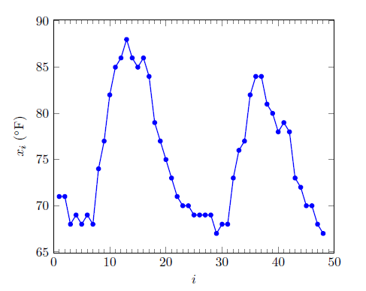
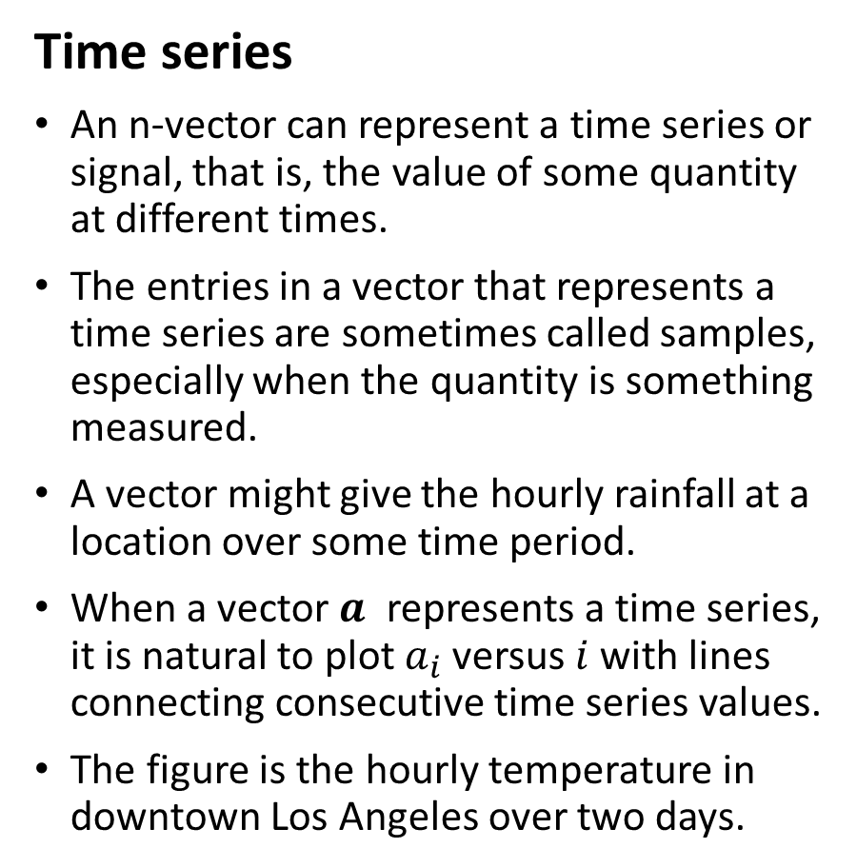
Representation our real world data using vectors
Time series
An n-vector can represent a time series or signal, that is, the value of some quantity at different times.
The entries in a vector that represents a time series are sometimes called samples, especially when the quantity is something measured.
A vector might give the hourly rainfall at a location over some time period.
When a vector $a$ represents a time series, it is natural to plot $a_{i}$versus $i$ with lines connecting consecutive time series values.
The figure is the hourly temperature in downtown Los Angeles over two days.

Slide 16
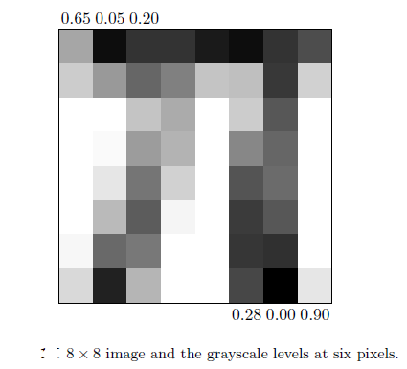
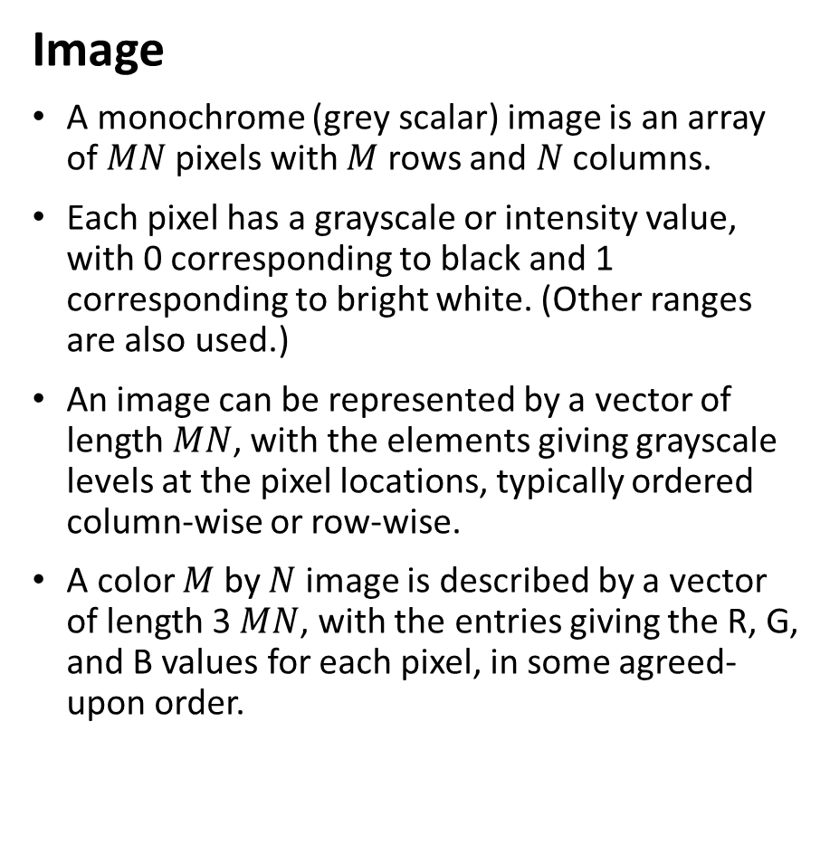
Representation our real world data using vectors
Image
A monochrome (grey scalar) image is an array of $MN$pixels with $M$ rows and $N$ columns.
Each pixel has a grayscale or intensity value, with 0 corresponding to black and 1 corresponding to bright white. (Other ranges are also used.)
An image can be represented by a vector of length $MN$, with the elements giving grayscale levels at the pixel locations, typically ordered column-wise or row-wise.
A color $M$ by $N$ image is described by a vector of length 3 $MN$, with the entries giving the R, G, and B values for each pixel, in some agreed-upon order.

Slide 17
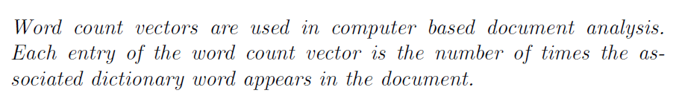
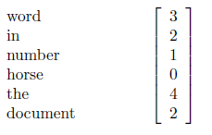
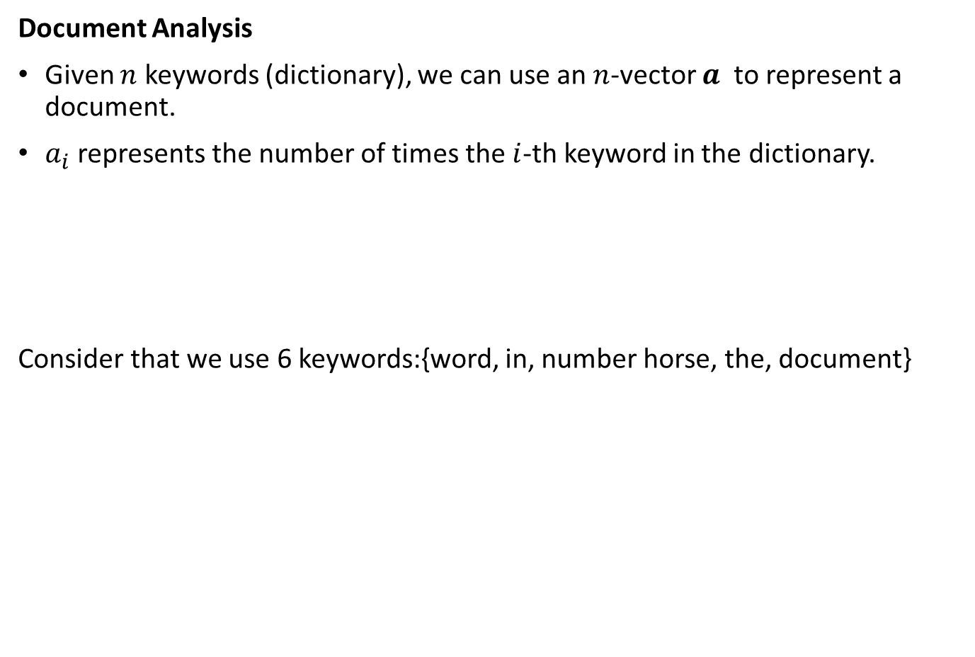
Representation our real world data using vectors
Document Analysis
Given $n$ keywords (dictionary), we can use an $n$-vector $a$ to represent a document.
$a_{i}$represents the number of times the $i$-th keyword in the dictionary.
Consider that we use 6 keywords:{word, in, number horse, the, document}
Common practice : count variations of a word as the same word; for example, `rain', `rains', `raining’ and ‘rained’ are counted as `rain‘.

Slide 18
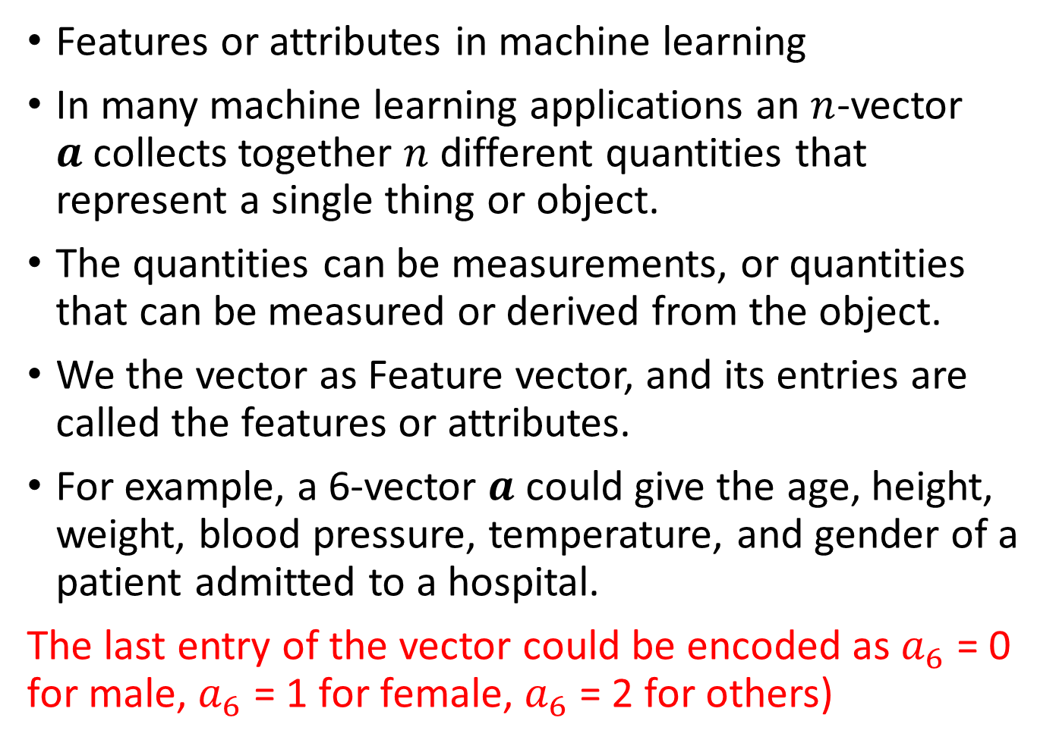
Representation our real world data using vectors
Features or attributes in machine learning
In many machine learning applications an $n$-vector $a$collects together $n$ different quantities that represent a single thing or object.
The quantities can be measurements, or quantities that can be measured or derived from the object.
We the vector as Feature vector, and its entries are called the features or attributes.
For example, a 6-vector $a$ could give the age, height, weight, blood pressure, temperature, and gender of a patient admitted to a hospital.
The last entry of the vector could be encoded as $a_{6}$ = 0 for male, $a_{6}$ = 1 for female, $a_{6}$ = 2 for others)

Slide 19
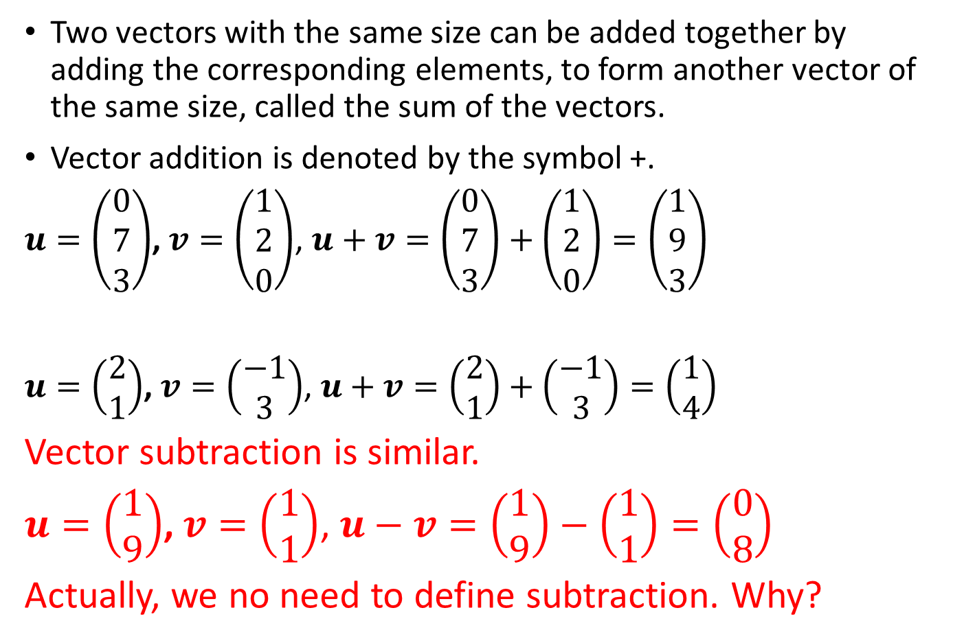
Addition
Two vectors with the same size can be added together by adding the corresponding elements, to form another vector of the same size, called the sum of the vectors.
Vector addition is denoted by the symbol +.
$u=\left(\begin{matrix}0 \\ 7 \\ 3\end{matrix}\right)$, $v=\left(\begin{matrix}1 \\ 2 \\ 0\end{matrix}\right)$, $u+v=\left(\begin{matrix}0 \\ 7 \\ 3\end{matrix}\right)+\left(\begin{matrix}1 \\ 2 \\ 0\end{matrix}\right)=\left(\begin{matrix}1 \\ 9 \\ 3\end{matrix}\right)$
$u=\left(\begin{matrix}2 \\ 1\end{matrix}\right)$, $v=\left(\begin{matrix}−1 \\ 3\end{matrix}\right)$, $u+v=\left(\begin{matrix}2 \\ 1\end{matrix}\right)+\left(\begin{matrix}−1 \\ 3\end{matrix}\right)=\left(\begin{matrix}1 \\ 4\end{matrix}\right)$
Vector subtraction is similar.
$u=\left(\begin{matrix}1 \\ 9\end{matrix}\right)$, $v=\left(\begin{matrix}1 \\ 1\end{matrix}\right)$, $u−v=\left(\begin{matrix}1 \\ 9\end{matrix}\right)−\left(\begin{matrix}1 \\ 1\end{matrix}\right)=\left(\begin{matrix}0 \\ 8\end{matrix}\right)$
Actually, we no need to define subtraction. Why?

Slide 20
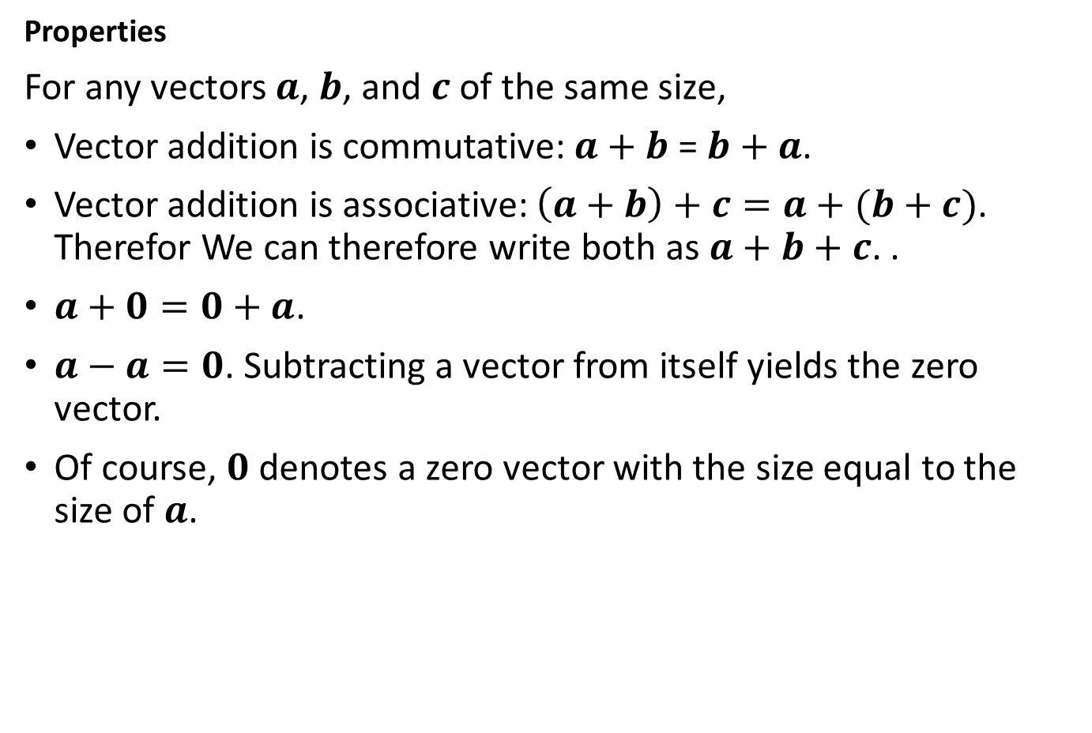
Addition
Properties
For any vectors $a$, $b$, and $c$ of the same size,
Vector addition is commutative: $a+b$ = $b+a$.
Vector addition is associative: $\left(a+b\right)+c=a+(b+c)$. Therefor We can therefore write both as $a+b+c$. .
$a+0=0+a$.
$a−a=0$. Subtracting a vector from itself yields the zero vector.
Of course, $0$ denotes a zero vector with the size equal to the size of $a$.

Slide 21
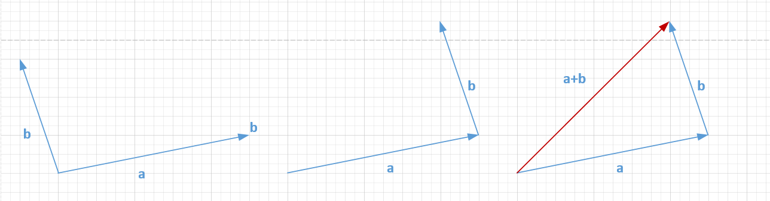
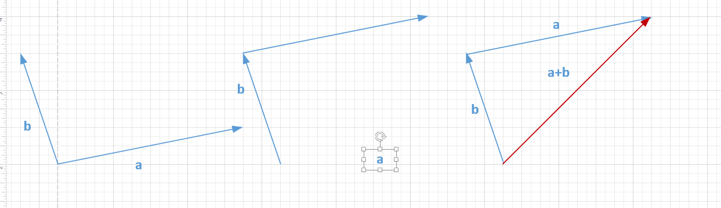
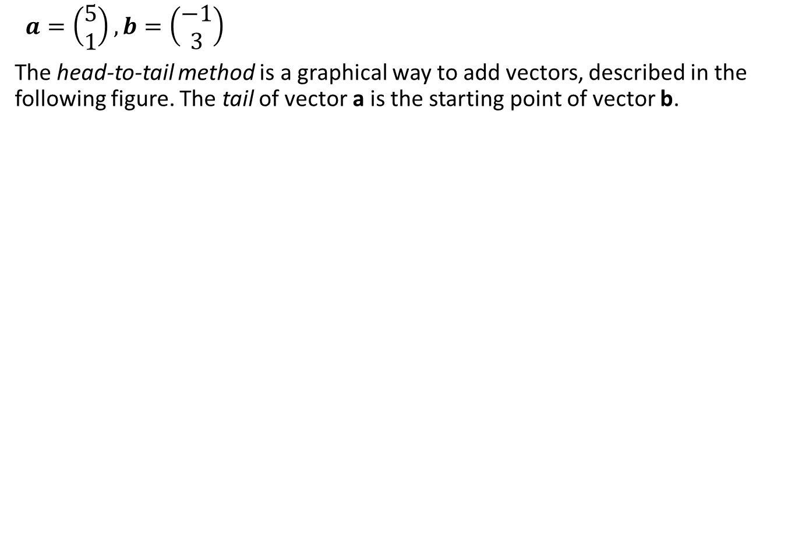
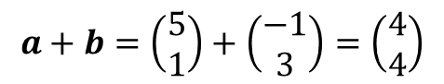
Addition Graphical illustration
$a=\left(\begin{matrix}5 \\ 1\end{matrix}\right), b=\left(\begin{matrix}−1 \\ 3\end{matrix}\right)$
The head-to-tail method is a graphical way to add vectors, described in the following figure. The tail of vector a is the starting point of vector b.
$$a+b=\left(\begin{matrix}5 \\ 1\end{matrix}\right)+\left(\begin{matrix}−1 \\ 3\end{matrix}\right)=\left(\begin{matrix}4 \\ 4\end{matrix}\right)$$

Slide 22
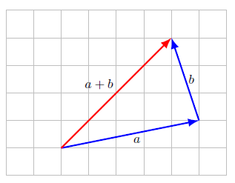
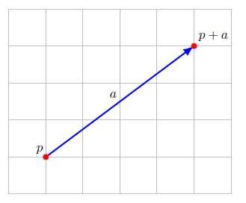
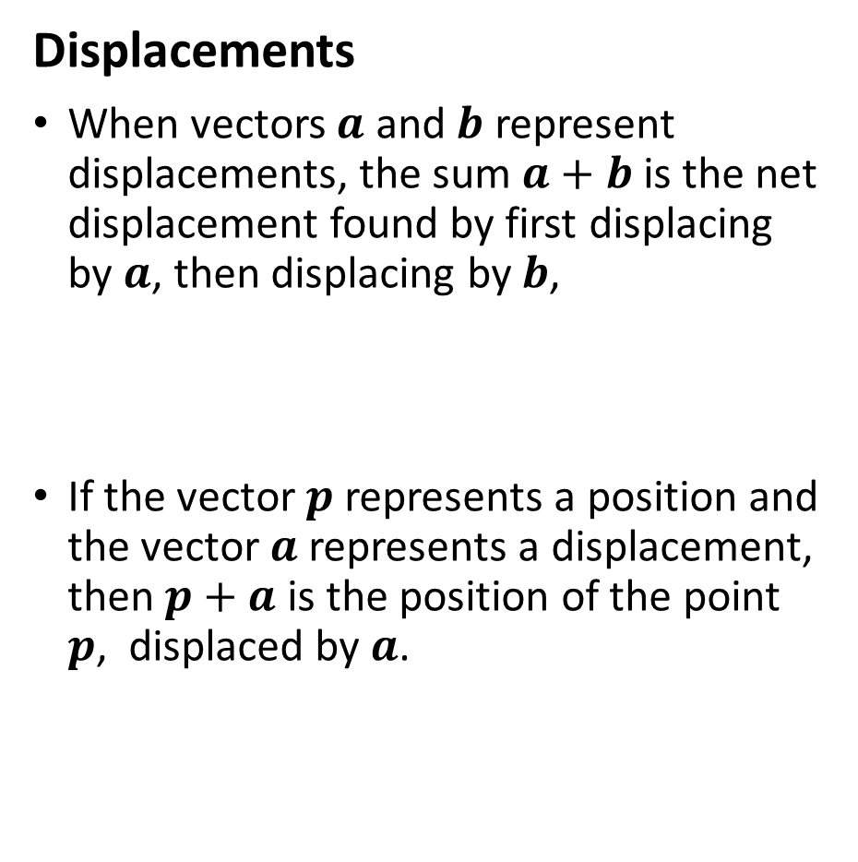
Examples
Displacements
When vectors $a$ and $b$ represent displacements, the sum $a+b$ is the net displacement found by first displacing by $a$, then displacing by $b$,
If the vector $p$ represents a position and the vector $a$ represents a displacement, then $p+a$ is the position of the point $p$, displaced by $a$.

Slide 23
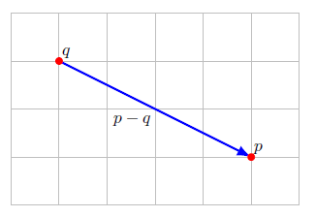
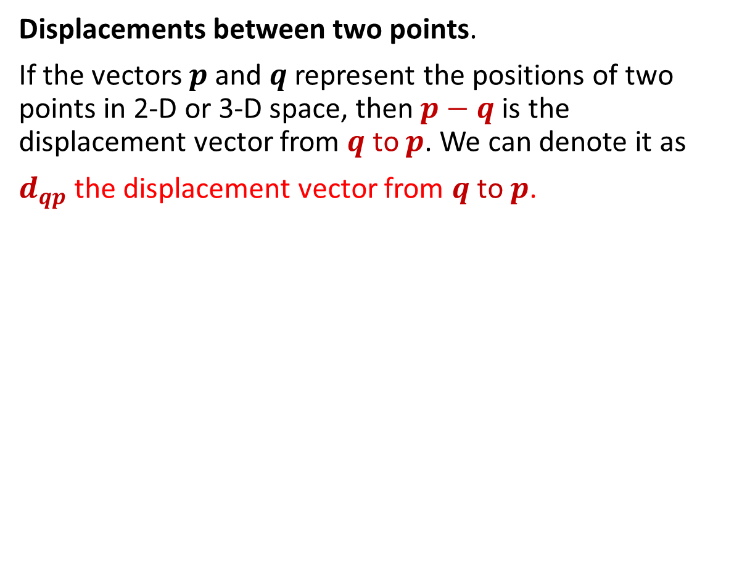
Examples
Displacements between two points.
If the vectors $p$ and $q$ represent the positions of two points in 2-D or 3-D space, then $p−q$is the displacement vector from $q$ to $p$. We can denote it as
$d_{qp}$ the displacement vector from $q$ to $p$.

Slide 24
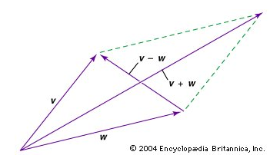
Examples
Addition examples:

Slide 25
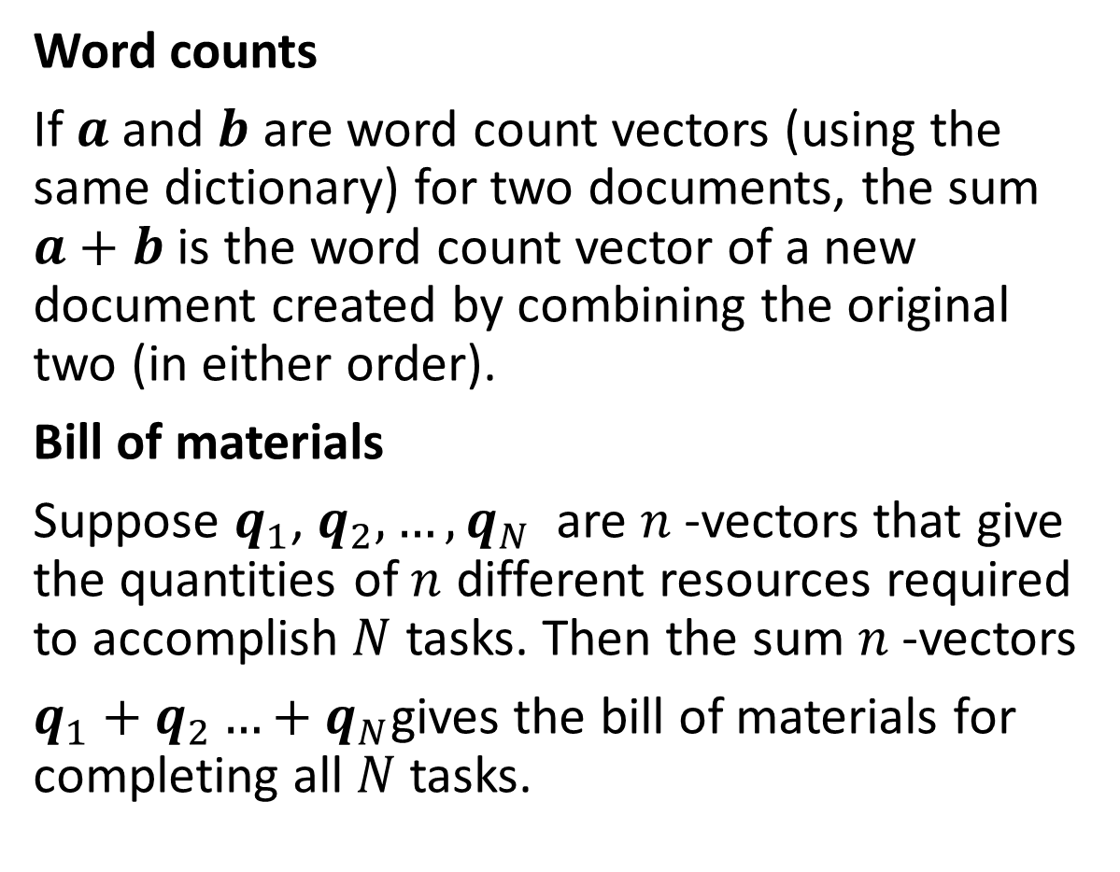
Examples
Word counts
If $a$ and $b$ are word count vectors (using the same dictionary) for two documents, the sum $a+b$ is the word count vector of a new document created by combining the original two (in either order).
Bill of materials
Suppose $q_{1}$, $q_{2},…,q_{N}$ are $n$-vectors that give the quantities of $n$ different resources required to accomplish $N$ tasks. Then the sum $n$-vectors
$q_{1}+q_{2}…+q_{N}$gives the bill of materials for completing all $N$ tasks.

Slide 26
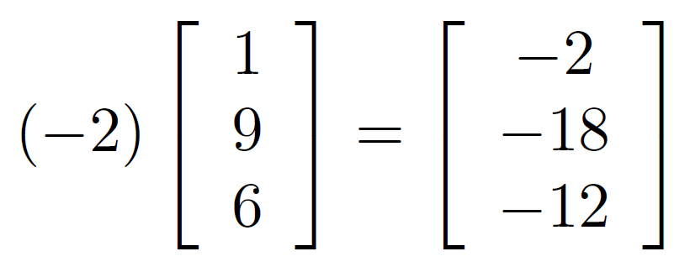
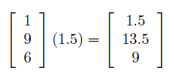
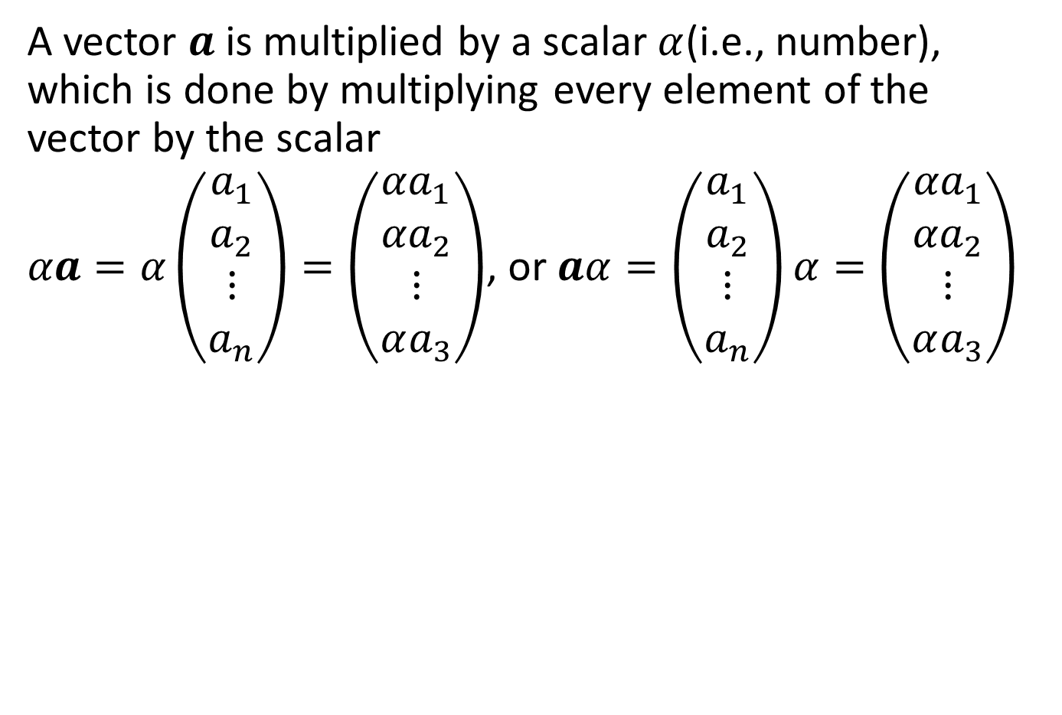
Scalar Multiplication
A vector $a$is multiplied by a scalar $α$(i.e., number), which is done by multiplying every element of the vector by the scalar
$αa=α\left(\begin{matrix}a_{1} \\ a_{2} \\ ⋮ \\ a_{n}\end{matrix}\right)=\left(\begin{matrix}{αa}_{1} \\ {αa}_{2} \\ ⋮ \\ αa_{3}\end{matrix}\right)$, or $aα=\left(\begin{matrix}a_{1} \\ a_{2} \\ ⋮ \\ a_{n}\end{matrix}\right)α=\left(\begin{matrix}{αa}_{1} \\ {αa}_{2} \\ ⋮ \\ αa_{3}\end{matrix}\right)$

Slide 27
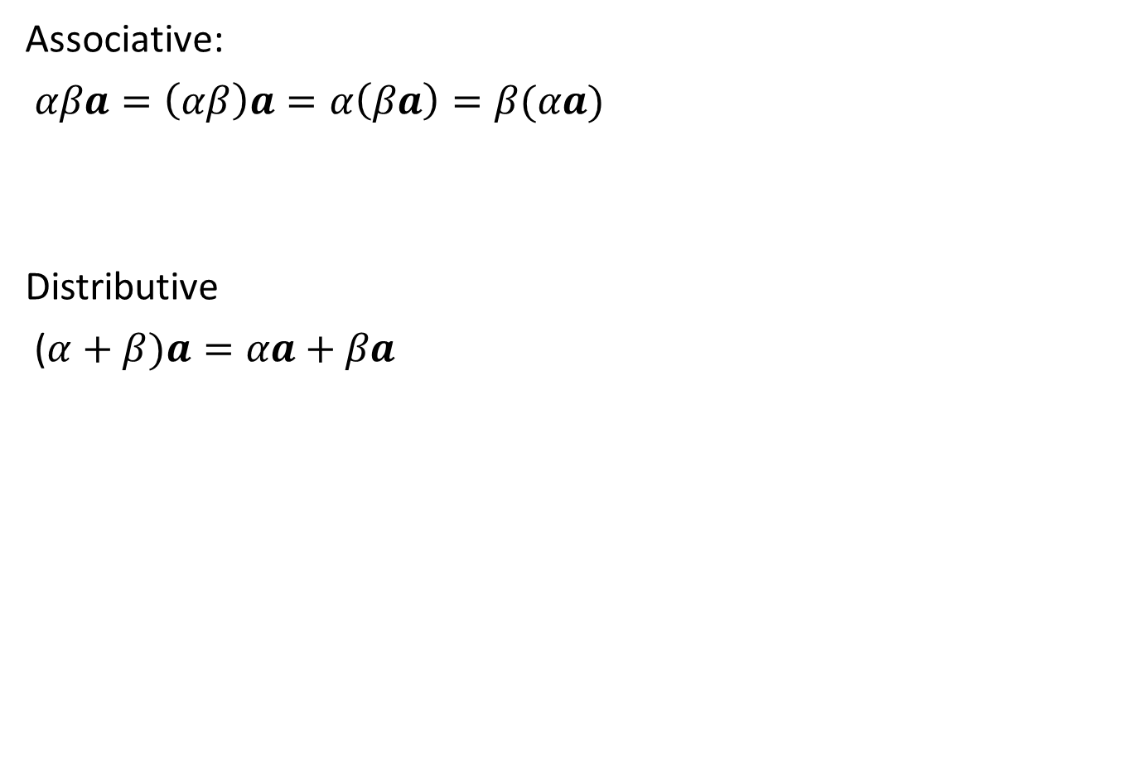
Scalar Multiplication
Associative:
$αβa=\left(αβ\right)a=α\left(βa\right)=β(αa)$
Distributive
($α+β)a=αa+βa$

Slide 28
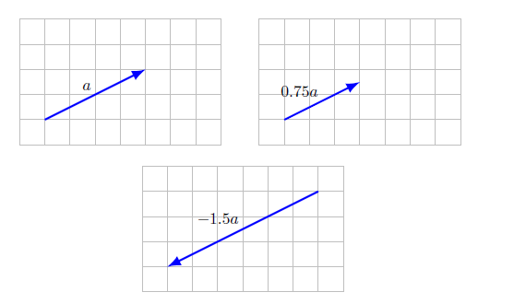
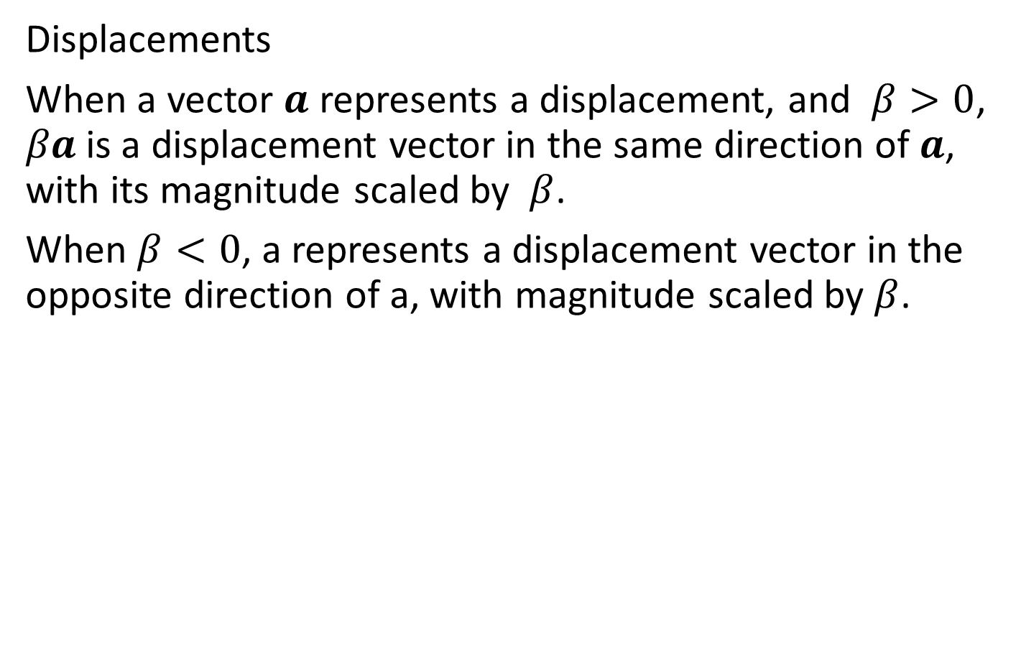
Scalar Multiplication (Example)
Displacements
When a vector $a$ represents a displacement, and $β>0$, $βa$is a displacement vector in the same direction of $a$, with its magnitude scaled by $β$.
When $β<0$, a represents a displacement vector in the opposite direction of a, with magnitude scaled by $β$.

Slide 29
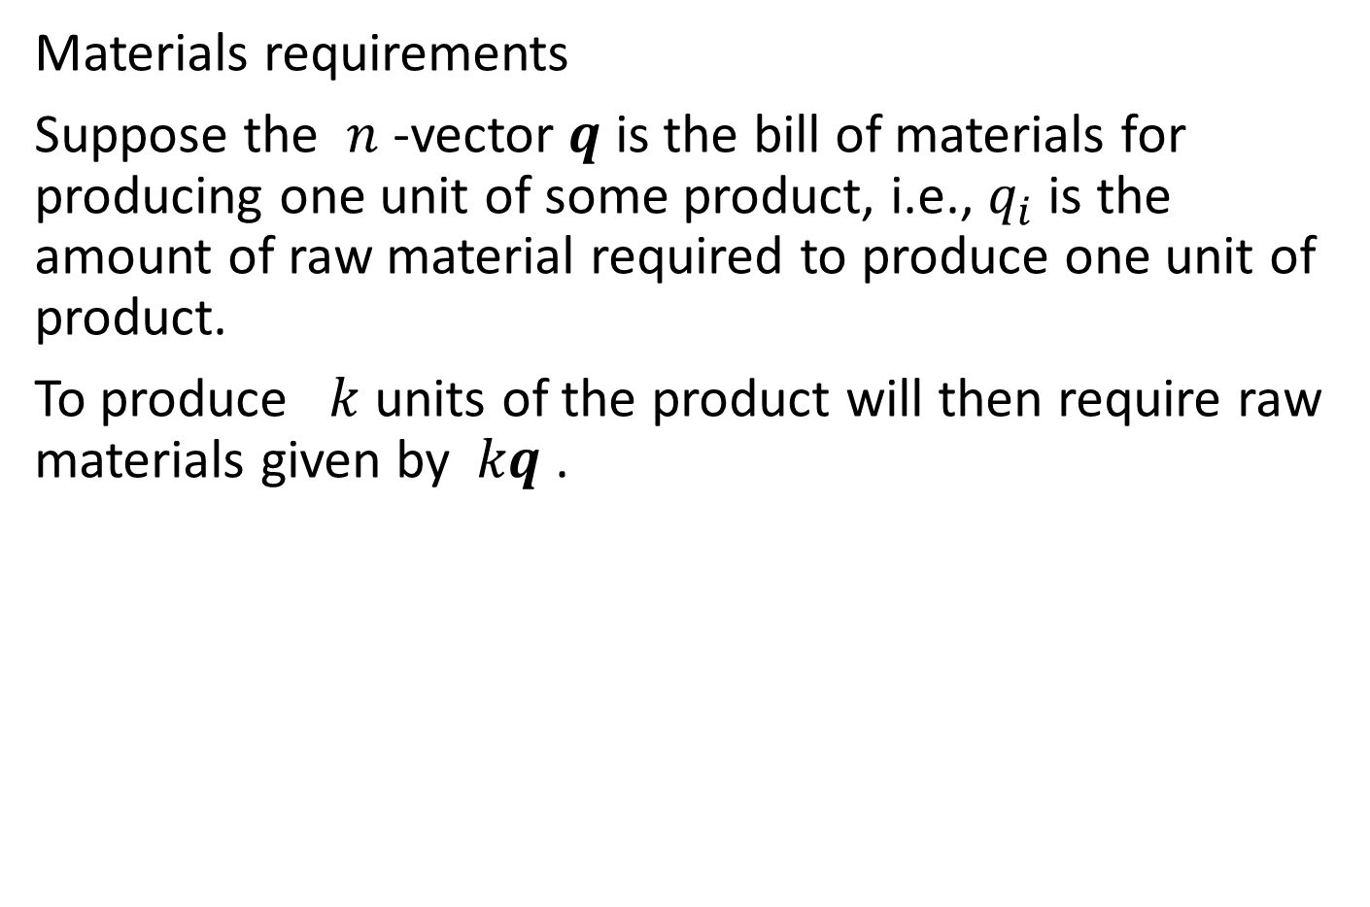
Scalar Multiplication (Example)
Materials requirements
Suppose the $n$ -vector $q$ is the bill of materials for producing one unit of some product, i.e., $q_{i}$ is the amount of raw material required to produce one unit of product.
To produce $k$ units of the product will then require raw materials given by $kq$ .

Slide 30
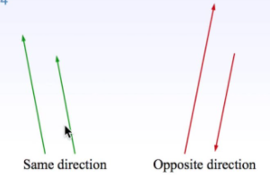
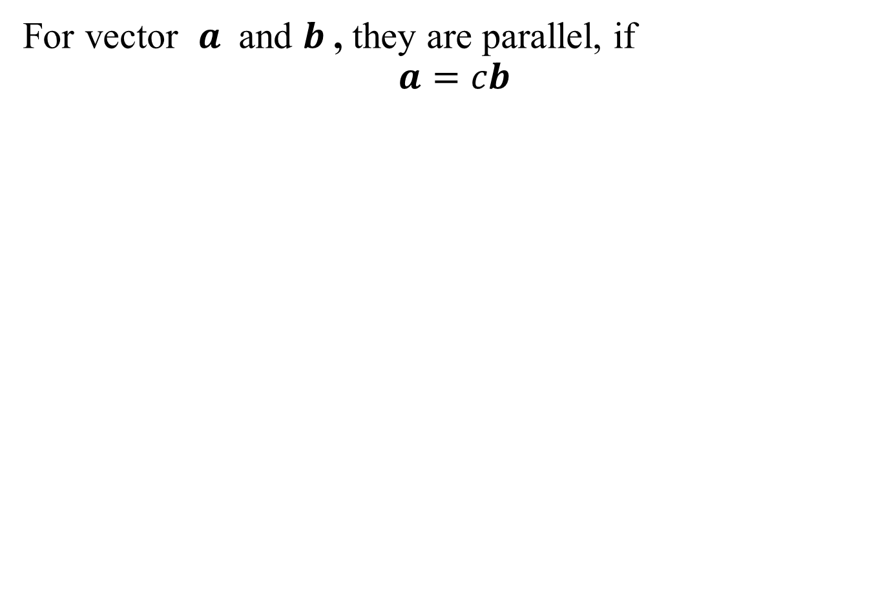
Parallel Vector
For vector $a$ and $b$, they are parallel, if
$$a=cb$$

Slide 31
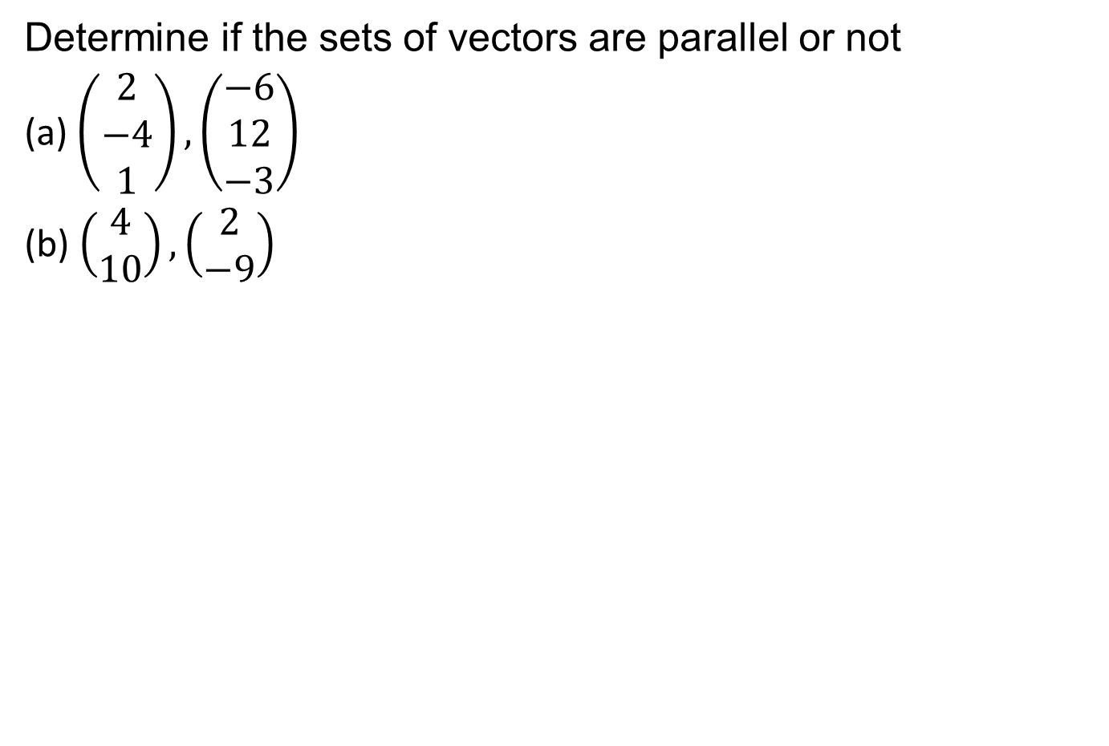
Example for parallel vectors
Determine if the sets of vectors are parallel or not
(a)$\left(\begin{matrix}2 \\ −4 \\ 1\end{matrix}\right),\left(\begin{matrix}−6 \\ 12 \\ −3\end{matrix}\right)$
(b) $\left(\begin{matrix}4 \\ 10\end{matrix}\right),\left(\begin{matrix}2 \\ −9\end{matrix}\right)$

Slide 32
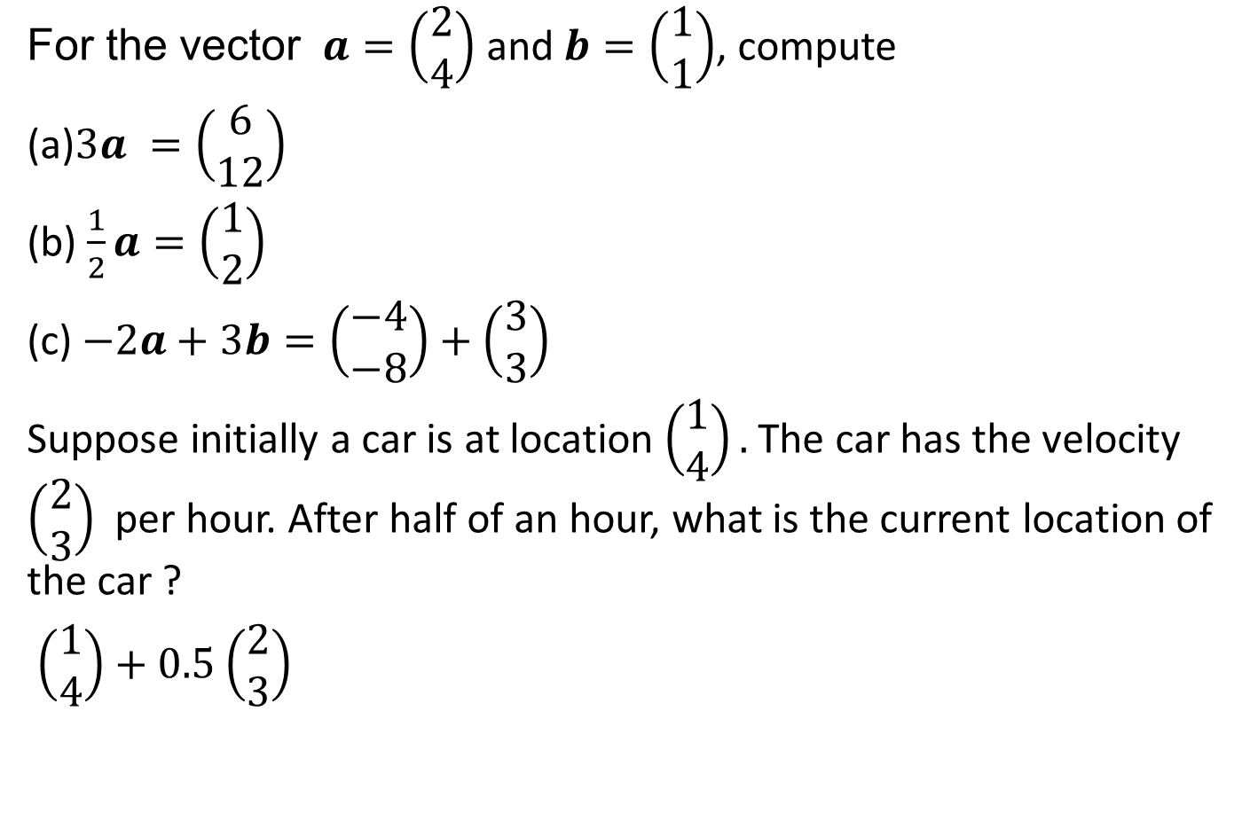
Example for scalar multiplication and addition
For the vector $a=\left(\begin{matrix}2 \\ 4\end{matrix}\right)$ and $b=\left(\begin{matrix}1 \\ 1\end{matrix}\right)$, compute
(a)$3a =\left(\begin{matrix}6 \\ 12\end{matrix}\right)$
(b) $\frac{1}{2}a=\left(\begin{matrix}1 \\ 2\end{matrix}\right)$
(c) $−2a+3b=\left(\begin{matrix}−4 \\ −8\end{matrix}\right)+\left(\begin{matrix}3 \\ 3\end{matrix}\right)$
Suppose initially a car is at location $\left(\begin{matrix}1 \\ 4\end{matrix}\right).$ The car has the velocity $\left(\begin{matrix}2 \\ 3\end{matrix}\right)$ per hour. After half of an hour, what is the current location of the car ?
$\left(\begin{matrix}1 \\ 4\end{matrix}\right)+0.5$ $\left(\begin{matrix}2 \\ 3\end{matrix}\right)$

Slide 33
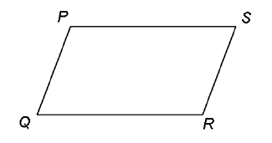
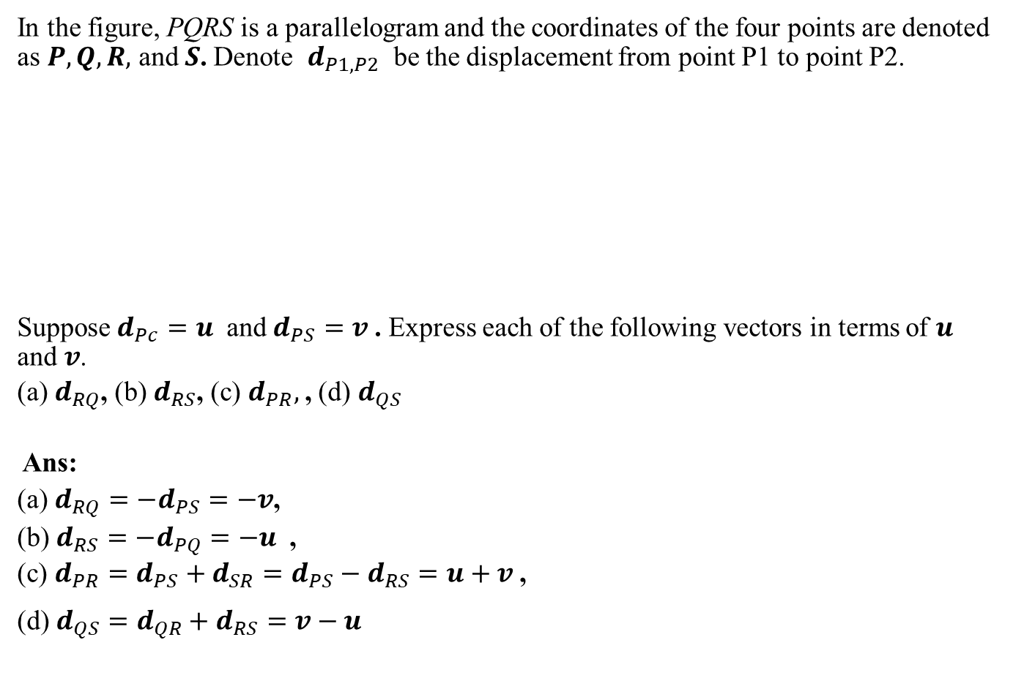
Example for scalar multiplication and addition
In the figure, PQRS is a parallelogram and the coordinates of the four points are denoted as $P, Q, R,$ and $S$. Denote $d_{P1,P2}$ be the displacement from point P1 to point P2.
Suppose $d_{Pc}=u$ and $d_{PS}=v$. Express each of the following vectors in terms of $u$ and $v$.
(a) $d_{RQ}$, (b) $d_{RS}$, (c) $d_{PR},$, (d) $d_{QS}$
Ans:
(a) $d_{RQ}=−d_{PS}=−v$,
(b) $d_{RS}=−d_{PQ}=−u$ ,
(c) $d_{PR}=d_{PS}+d_{SR}=d_{PS}−d_{RS}=u+v$,
(d) $d_{QS}=d_{QR}+d_{RS}=v−u$

Slide 34
Example for scalar multiplication and addition
For the vector $a=\left(\begin{matrix}2 \\ 4\end{matrix}\right)$ and $b=\left(\begin{matrix}1 \\ 1\end{matrix}\right)$, compute
(a)$3a =\left(\begin{matrix}6 \\ 12\end{matrix}\right)$
(b) $\frac{1}{2}a=\left(\begin{matrix}1 \\ 2\end{matrix}\right)$
(c) $−2a+3b=\left(\begin{matrix}−4 \\ −8\end{matrix}\right)+\left(\begin{matrix}3 \\ 3\end{matrix}\right)$
Suppose initially a car is at location $\left(\begin{matrix}1 \\ 4\end{matrix}\right).$ The car has the velocity $\left(\begin{matrix}2 \\ 3\end{matrix}\right)$ per hour. After half of an hour, what is the current location of the car ?
$\left(\begin{matrix}1 \\ 4\end{matrix}\right)+0.5$ $\left(\begin{matrix}2 \\ 3\end{matrix}\right)$

Slide 35
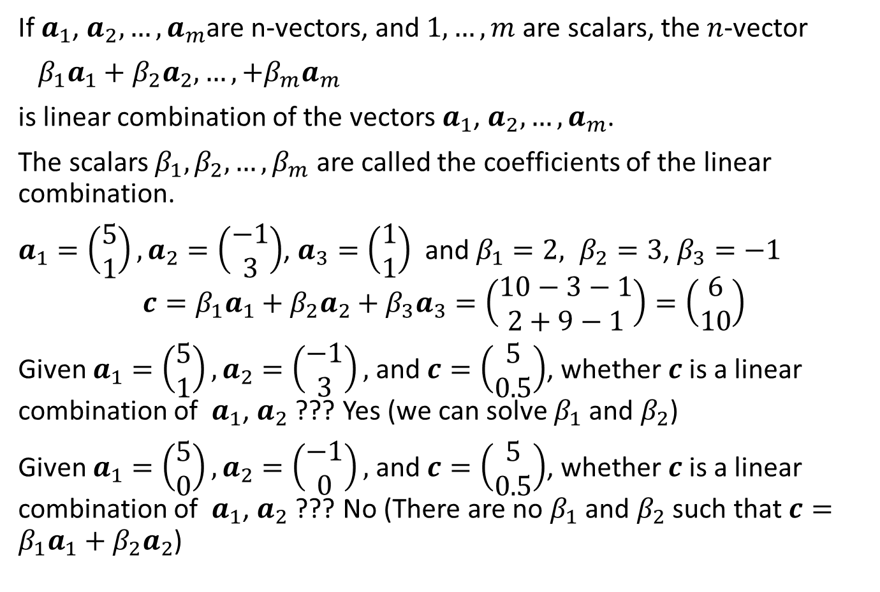
Linear combinations
If $a_{1}$, $a_{2},…,a_{m}$are n-vectors, and $1,…,m$ are scalars, the $n$-vector
$β_{1}a_{1}+β_{2}a_{2},…,+β_{m}a_{m}$
is linear combination of the vectors $a_{1}$, $a_{2},…,a_{m}$.
The scalars $β_{1},β_{2}, …,β_{m}$ are called the coefficients of the linear combination.
$a_{1}=\left(\begin{matrix}5 \\ 1\end{matrix}\right),a_{2}=\left(\begin{matrix}−1 \\ 3\end{matrix}\right)$, $a_{3}=\left(\begin{matrix}1 \\ 1\end{matrix}\right)$ and $β_{1}=2, β_{2}=3$, $β_{3}=−1$
$$c=β_{1}a_{1}+β_{2}a_{2}+β_{3}a_{3}=\left(\begin{matrix}10−3−1 \\ 2+9−1\end{matrix}\right)=\left(\begin{matrix}6 \\ 10\end{matrix}\right)$$
Given $a_{1}=\left(\begin{matrix}5 \\ 1\end{matrix}\right),a_{2}=\left(\begin{matrix}−1 \\ 3\end{matrix}\right),$and $c=\left(\begin{matrix}5 \\ 0.5\end{matrix}\right)$, whether $c$ is a linear combination of $a_{1}$, $a_{2}$ ??? Yes (we can solve $β_{1}$ and $β_{2}$)
Given $a_{1}=\left(\begin{matrix}5 \\ 0\end{matrix}\right),a_{2}=\left(\begin{matrix}−1 \\ 0\end{matrix}\right),$and $c=\left(\begin{matrix}5 \\ 0.5\end{matrix}\right)$, whether $c$ is a linear combination of $a_{1}$, $a_{2}$ ??? No (There are no $β_{1}$ and $β_{2}$ such that $c=β_{1}a_{1}+β_{2}a_{2}$)

Slide 36


Special Linear combination
We can write any $n$-vector $b$ as a linear combination of the standard unit vectors, as
$b=b_{1}e_{1}+b_{2}e_{2}$+…, $b_{n}e_{n}$
In linear algebra, $e_{1},e_{2},$…, $e_{n}$ form a basis.
Any $n$-vector can be written as a linear combination of $e_{1},e_{2},$…, $e_{n}$.

Slide 37

Linear combination of standard unit vectors.
Some linear combinations of the vectors have special names.
The linear combination with $β_{1}=β_{2}=,$…, $β_{m}=1$, given by $a_{1}+a_{2},..+a_{m}$, is the sum of the vectors.
The linear combination with $β_{1}=β_{2}=,$…, $β_{m}=1/m$ given by $\frac{1}{m}(a_{1}+a_{2},..+a_{m})$, is the average of the vectors.
Also, given $m$ $n$-vectors $a_{1},a_{2},$…, $a_{m}$ with $m<n$, we can use a linear combination to define a linear sub-space, given by $β_{1}a_{1}+β_{2}a_{2},..+β_{m}a_{m}$, where $β_{i}$’s are real numbers. This is ${c=β}_{1}a_{1}+β_{2}a_{2},..+β_{m}a_{m}$ for real $β_{i}$’s . Any vector in this subspace is a linear combination of $a_{1},a_{2},$…, $a_{m}$.

Slide 38




Examples
Displacements
When the vectors represent displacements, a linear combination is the sum of the scaled displacements.
Audio mixing
When $a_{1},a_{2},$…, $a_{m}$are vectors representing audio signals (over the same period of time, for example, simultaneously recorded), they are called tracks. The linear combination $β_{1}a_{1}+β_{2}a_{2},..+β_{m}a_{m}$ is perceived as a mixture of the audio tracks.

Slide 39


Example
Line and segment
Line:
When $a$ and $b$ are different $n$-vectors, the combination $c=\left(1−θ\right)a+θb$, where $θ$is a scalar, describes a point on the line passing through $a$ and $b$.
Line segment:
These points are on the line passing through $a$ and $b$. For $0≤θ≤1$, the points are on the line segment between $a$ and $b$.
We use two vectors in this form: $c=\left(1−θ\right)a+θb$ to define a set.

Slide 40


Example
Given $x_{1},x_{2},$…, $x_{m},$
we can use ${y=ax}_{1}$ to define a subspace
we can use $y=a_{1}x_{1}+a_{2}x_{2}$to define a subspace

Slide 41


Inner product
The inner product of two $n$-vectors $a$ and $b$ is defined as
$$a^{T}b=a_{1}b_{1}+…,+a_{n}b_{n}.$$
Other notation: $a⋅b$ .
The notation of ‘$T^{′}$ will be explained later.

Slide 42

Inner product
Properties
Commutativity : $a^{T}b$ = $b^{T}a$. The order of the two vector arguments in the
Associativity with scalar multiplication:
${(βa)}^{T}b=a^{T}(βb)$
Distributivity with vector addition:
${(a+b)}^{T}c=a^{T}c$+$b^{T}c$

Slide 43

Inner product
Block vectors. If the vectors $a$ and $b$ are block vectors,
${\left(\begin{matrix}a_{1} \\ a_{2} \\ a_{3}\end{matrix}\right)}^{T}\left(\begin{matrix}b_{1} \\ b_{2} \\ b_{3}\end{matrix}\right)={a_{1}}^{T}b_{1}+{a_{2}}^{T}b_{2}+{a_{3}}^{T}b_{3}$.

Slide 44

Example
Portfolio value
Suppose $s$ is an $n$-vector representing the holdings in shares of a portfolio of $n$ different assets, with negative values meaning short positions.
If $p$ is an $n$-vector giving the prices of the assets, then $p^{T}s$ is the total (or net) value of the portfolio.
Portfolio return. Suppose $r$ is the vector of (fractional) returns of $n$ assets over some time period:
$$r_{i}=\frac{p_{i}^{final}−p_{i}^{init}}{p_{i}^{init}}$$
If $s$ is an $n$-vector giving our portfolio, with $s_{i}$ denoting the dollar value of asset $i$, then the inner product $r^{T}s$ is the total return of the portfolio, in dollars, over the period.

Slide 45


Norm and Distance
The Euclidean norm of an $n$-vector $x :$
$\left\|x\right\|=\sqrt{x_{1}^{2}+x_{2}^{2},…,+x_{n}^{2}}=\sqrt{x^{T}x}$
Unit vector: A unit vector $x$ is a vector with $\left\|x\right\|=$1.

Slide 46

Norm and Distance
Properties of norm
Nonnegative homogeneity: $\left\|βx\right\|=\left|β\right|\left\|x\right\|$
Triangle inequality: $\left\|x+y\right\|≤\left\|x\right\|+\left\|y\right\|$
(Can You prove it ???)
Nonnegativity. $\left\|x\right\|≥0$.
Definiteness. $\left\|x\right\|$ = 0 if and only if $x$ = 0 .

Slide 47


Norm and Distance (distance)
We can use the norm to define the Euclidean distance between two vectors $a$ and $b$ as the norm of their difference:
$dist\left(a,b\right)=\left\|a−b\right\|$
dist$\left(a,b\right)=$ dist$\left(b,a\right)$
$u=\left[\begin{matrix}1.8 \\ 2.0 \\ −3.7 \\ 4.7\end{matrix}\right],v=\left[\begin{matrix}0.6 \\ 2.1 \\ 1.9 \\ −1.4\end{matrix}\right]$, w$=\left[\begin{matrix}2.0 \\ 1.9 \\ −4.0 \\ 4.6\end{matrix}\right]$
$\left\|u−v\right\|=8.368$, $\left\|u−w\right\|=0.387, \left\|v−w\right\|$=8.533

Slide 48


Norm and Distance (distance)
Triangle inequality
Given three vectors: $a,b$, and $c$
$\left\|a−c\right\|≤\left\|a−b\right\|+\left\|c−b\right\|$
Can you prove it ?

Slide 49

Norm and Distance (example)
Feature distance
If $x$ and $y$ represent vectors of $n$ features of two objects, the quantity $\left\|x−y\right\|$ is called the feature distance, and gives a measure of how different the objects are (in terms of their feature values).
Similarity of two patients
Each patient associates a feature vector with entries such as weight, age, presence of chest pain, difficulty breathing, and the results of tests. We can use feature vector distance to say that one patient case is near another one (at least in terms of their feature vectors).

Slide 50


Norm and Distance (example)
Nearest neighbor
$z_{1},z_{2},$…, $z_{m}$ : a collection of $m$ $n$-vectors
$x$: another $n$-vector.
If $\left\|x−z_{j}\right\|≤\left\|x−z_{i}\right\|$ for all $i≠j$,
$z_{j}$ is the nearest neighbor of $x$ (among $z_{1},z_{2},$…, $z_{m}$).
Or saying, $z_{j}$ is the closest vector (among $z_{1},z_{2},$…, $z_{m}$) to $x$.

Slide 51


Norm and Distance (example)
Document dissimilarity
Two $n$-vectors $x$ and $y$ represent the histograms of keyword occurrences for two documents. (assume that we a common set of keywords)
Then $\left\|x−y\right\|$ represents a measure of the dissimilarity of the two documents
Pairwise word count histogram distances between five Wikipedia articles

Slide 52

Angle
Cauchy-Schwarz inequality
An important inequality that relates norms and inner products is the Cauchy-Schwarz inequality:
$\left|a^{T}b\right|≤\left\|a\right\|\left\|b\right\|$for any $n$-vectors $a$ and $b$.
$$\left|a_{1}b_{1}+,…,+a_{n}a_{n}\right|≤ {\left(a_{1}^{2}+,…,+a_{n}^{2}\right)}^{1/2}{\left(b_{1}^{2}+,…,+b_{n}^{2}\right)}^{1/2}$$
The proof : (Not in exam)
Let $α=\left\|a\right\|$ and $β=\left\|b\right\|$
Consider
$0≤{\left\|βa−αb\right\|}^{2}$
$={\left\|βa\right\|}^{2}−2{\left(βa\right)}^{T}αb+{\left\|αb\right\|}^{2}$
$=β^{2}{\left\|a\right\|}^{2}−2αβ{\left(a\right)}^{T}b+α^{2}{\left\|b\right\|}^{2}$
$={\left\|b\right\|}^{2}{\left\|a\right\|}^{2}−2\left\|a\right\|\left\|b\right\|{\left(a\right)}^{T}b+{\left\|a\right\|}^{2}{\left\|b\right\|}^{2}$
$={\left\|b\right\|}^{2}{\left\|a\right\|}^{2}−\left\|a\right\|\left\|b\right\|{\left(a\right)}^{T}=\left\|a\right\|\left\|b\right\|−{\left(a\right)}^{T}b$

Slide 53


Angle
The angle $θ$ between two nonzero vectors $a$ and $b$:
$$∠\left(a,b\right)=θ=\cos^{−1}{(\frac{a^{T}b}{\left\|a\right\|\left\|b\right\|})}$$
where $\cos^{−1}$ denotes the inverse cosine.
$$a^{T}b=\left\|a\right\|\left\|b\right\|\cos{θ}$$
Example:
$$a=\left(\begin{matrix}1 \\ 2 \\ −1\end{matrix}\right), b=\left(\begin{matrix}2 \\ 0 \\ −3\end{matrix}\right)$$

Slide 54


Acute and obtuse angles
Angles are classified according to the sign of $a^{T}b$.
Suppose the two vectors nonzero $n$-vectors.
Orthogonal: $a^{T}b=0$, $θ={90}^{°}$, $θ=π/2$
Alighted:$a^{T}b=\left\|a\right\|\left\|b\right\|$, $θ=0^{°}$, $θ=0$
Anti-alighted:$a^{T}b=−\left\|a\right\|\left\|b\right\|$, $θ=π$
Acute angle: $θ<$ $\frac{π}{2}={90}^{°}$
Obtuse angle $θ>$ $\frac{π}{2}={90}^{°}$

Slide 55


Angle of unit vectors
Unit vectors
If $a$ and $b$are unit vectors, we can use of $a^{T}b$ or the angle between them to define the similarity between the two vectors.
Spherical distance
$a$ and $b$ are 3-vectors that represent two points on the sphere of radius 1. The spherical distance between them, measured along the sphere, is given by $∠\left(a,b\right)$.

Slide 56


Examples
Document similarity via angles.
$a$ and $b$ are $n$-vectors represent the word counts of two documents, their angle can be used as a measure of document dissimilarity.

Slide 57



Angle or Distance
Use angle $∠\left(a,b\right)$ or distance $\left\|a−b\right\|$
Problem dependent
See if the norm of your data vectors are close to a constant or not

Slide 58



Linear function
A linear function is a mapping that maps a real $n$-vector $x$ to a real number $y$.
$$y=f\left(x\right)=a_{0}+a_{1}x_{1}+,…,+a_{n}x_{n}$$
Only have first order term of $x_{i}$’s.
$x_{1}, …, x_{n}$: independent variables.
$a_{0}, …, a_{n}$: coefficients.
Note that we have more advanced definition of linear function in some senior courses.

Slide 59

Linear function
In some applications, we may define a linear function using the inner product
$y=f\left(x\right)=a_{0}+a_{1}x_{1}+,…,a_{n}x_{n}=a_{0}$+$a^{T}x$
A special form of linear function is the inner product function.
$y=f\left(x\right)=a_{1}x_{1}+,…,+a_{n}x_{n}=a^{T}x$
Superposition and linearity:
$$f\left(αx+βz\right)=αf\left(x\right)+βf\left(z\right)$$
for the inner product function.

Slide 60

Linear function
Example
$$y=f\left(x\right)=1+2x_{1}+3x_{2}$$
Satisfies Superposition and linearity?
$$y=f\left(x\right)=2x_{1}+3x_{2}$$
Satisfies Superposition and linearity?

Slide 61

Linear function
For general linear function:
$y=f\left(x\right)=a_{0}+a_{1}x_{1}+,…,+a_{n}x_{n}=a_{0}$+$a^{T}x$
If we have constraint on $α$ and $β$:$α+β=1$
The we have
Superposition and linearity:
$$f\left(αx+βz\right)=αf\left(x\right)+βf\left(z\right)$$

Slide 62

Approximation
How about nonlinear function:
Using approximation:

Slide 63

Linear Regression
In machine learning or data analysis
We have many the $n$-vector $x$ represents feature vectors.
$y=f\left(x\right)=a_{0}+a_{1}x_{1}+,…,+a_{n}x_{n}=a_{0}$+$a^{T}x$
a regression model. In this context,
The entries of $x$are called the independent variables and $y$ is called the prediction (output), since the regression model is typically an approximation or prediction of some true value $y$.

Slide 64


Linear Regression
In machine learning or data analysis
Suppose we have unknown system:
We assume the system output is
$y=f\left(x\right)=a_{0}+a_{1}x_{1}+,…,+a_{n}x_{n}=a_{0}$+$a^{T}x$
where $x_{i}$’s.
We do not know the exact equation
But we have some training pairs
$\left\{\left(y_{1},x_{1}\right),…,\left(y_{N},x_{N}\right)\right\}$
where $x_{i}$’s are $n$-vectors.
Our task is to find $a_{0},a_{1},…,a_{n}$ based on the training pairs.

Slide 65

Linear Regression
House price regression model
$y$: selling price of a house (thousands of dollars)
$x_{1}$ is the house area (in 1000 square feet),
$x_{2}$ is the number of bedrooms
If y represents the selling price of the house, in thousands of dollars, the regression model
$$y=a_{0}+a_{1}x_{1}+a_{2}x_{2}$$
Collect some real data and then find $a_{0},a_{1}, a_{2}$.

Slide 66



Linear Regression
$a_{1}=$148.73, $a_{2}=$18.85, $a_{0}$ = 54.40

Slide 67


Clustering
Suppose we have $N$ $n$-vector $x_{1},…,x_{N}$. The goal of clustering is to group or partition the vectors (if possible) into $k$ groups or clusters, with the vectors in each group close to each other.

Slide 68

Clustering Applications
Topic discovery
Suppose $x_{i}$’s are word histograms associated with $N$ documents. A clustering algorithm partitions the documents into $k$ groups, which typically can be interpreted as groups of documents with the same or similar topics.
Patient clustering
Suppose $x_{i}$’s are feature vectors associated with $N$ patients admitted to a hospital, a clustering algorithm clusters the patients into $k$ groups of similar patients.
Customer market segmentation
Suppose $x_{i}$’s give the quantities (or dollar values) of $n$ items purchased by customers over some period of time. A clustering algorithm will group the customers into $k$ market segments, which are groups of customers with similar purchasing patterns.

Slide 69

Clustering
$N$ $n$-vector $x_{1},…,x_{N}$
The goal of clustering is to group or partition the vectors (if possible) into $k$ groups or clusters.
Each group is represented a representative vector is
$$z_{1},…,z_{k}$$
$$z_{j}=\frac{1}{number of vectors in Group j}\sum_{x_{i} in Group j}{x_{i}}$$

Slide 70

K-mean
$N$ $n$-vector $x_{1},…,x_{N}$ and $k$ initial representative vectors$z_{1},…,z_{k}$
Repeat until convergence
Partition the vectors into k groups. For each vector $i=1,..,N$, assign to the group $j$ if $\left\|x_{i}−z_{j}\right\|<\left\|x_{i}−z_{j′}\right\|$, for all $j′$ not equal to $j$. That is $z_{j}$ is the nearest representative.
Update representatives. For each group $j=1,..,k$,
set $z_{j}$ to be the mean of the vectors in group $j$.
$$z_{j}=\frac{1}{number of vectors in Group j}\sum_{x_{i} in Group j}{x_{i}}$$

Slide 71

Clustering
Left: before the update
right: after the update

Slide 72


Clustering
Left: before the update
right: after the update

Slide 73

K-mean
4 vectors $x_{1}=\left[\begin{matrix}1 \\ 1\end{matrix}\right],x_{2}=\left[\begin{matrix}2 \\ 1\end{matrix}\right]$, $x_{3}=\left[\begin{matrix}4 \\ 3\end{matrix}\right]$, $x_{4}=\left[\begin{matrix}5 \\ 4\end{matrix}\right]$
2 representative with initial $z_{1}=\left[\begin{matrix}1 \\ 1\end{matrix}\right],z_{2}=\left[\begin{matrix}2 \\ 1\end{matrix}\right]$
First iteration:
Partition the vectors into k groups.
Distances:
$\left\|x_{1}−z_{1}\right\|=0,$ $\left\|x_{1}−z_{2}\right\|=1$ , =>$x_{1}$ in Group 1
$\left\|x_{2}−z_{1}\right\|=1,$ $\left\|x_{2}−z_{2}\right\|=0$ , =>$x_{2}$ in Group 2
$\left\|x_{3}−z_{1}\right\|=3.6,$ $\left\|x_{3}−z_{2}\right\|=2.83$ , =>$x_{3}$ in Group 2
$\left\|x_{4}−z_{1}\right\|=5,$ $\left\|x_{4}−z_{2}\right\|=4.24$ , =>$x_{4}$ in Group 2
$$z_{1}=\left[\begin{matrix}1 \\ 1\end{matrix}\right],z_{2}=\frac{1}{3} \left(\left[\begin{matrix}2 \\ 1\end{matrix}\right]\text{+}\left[\begin{matrix}4 \\ 3\end{matrix}\right]+\left[\begin{matrix}5 \\ 4\end{matrix}\right]\right)=\left[\begin{matrix}11/3 \\ 8/3\end{matrix}\right]$$
For each vector $i=1,..,N$, assign to the group $j$ if $\left\|x_{i}−z_{j}\right\|<\left\|x_{i}−z_{j′}\right\|$, for all $j′$ not equal to $j$. That is $z_{j}$ is the nearest representative.
Update representatives. For each group $j=1,..,k$,
set $z_{j}$ to be the mean of the vectors in group $j$.
$$z_{j}=\frac{1}{number of vectors in Group j}\sum_{x_{i} in Group j}{x_{i}}$$

Slide 74

K-mean
Second iteration:
Partition the vectors into k groups.
$$z_{1}=\left[\begin{matrix}1 \\ 1\end{matrix}\right],z_{2}=\left[\begin{matrix}11/3 \\ 8/3\end{matrix}\right]$$
Distances:
$\left\|x_{1}−z_{1}\right\|=0,$ $\left\|x_{1}−z_{2}\right\|=3.14$ , =>$x_{1}$ in Group 1
$\left\|x_{2}−z_{1}\right\|=1,$ $\left\|x_{2}−z_{2}\right\|=2.36$ , =>$x_{2}$ in Group 1
$\left\|x_{3}−z_{1}\right\|=3.6,$ $\left\|x_{3}−z_{2}\right\|=0.47$ , =>$x_{3}$ in Group 2
$\left\|x_{4}−z_{1}\right\|=5,$ $\left\|x_{4}−z_{2}\right\|=1.89$ , =>$x_{4}$ in Group 2
$$z_{1}=\left[\begin{matrix}(1+2)/2 \\ (1+1)/2\end{matrix}\right]=\left[\begin{matrix}1.5 \\ 1\end{matrix}\right],z_{2}=\left[\begin{matrix}(4+5)/2 \\ (3+4)/2\end{matrix}\right]=\left[\begin{matrix}4.5 \\ 3.5\end{matrix}\right]$$

Slide 75

K-mean
Third iteration:
Partition the vectors into k groups.
$$z_{1}=\left[\begin{matrix}1.5 \\ 1\end{matrix}\right],z_{2}=\left[\begin{matrix}4.5 \\ 3.5\end{matrix}\right]$$
Distances:
$\left\|x_{1}−z_{1}\right\|=0.5,$ $\left\|x_{1}−z_{2}\right\|=4.30$ , =>$x_{1}$ in Group 1
$\left\|x_{2}−z_{1}\right\|=0.5$, $\left\|x_{2}−z_{2}\right\|=3.54$ , =>$x_{2}$ in Group 1
$\left\|x_{3}−z_{1}\right\|=3.2,$ $\left\|x_{3}−z_{2}\right\|=0.71$ , =>$x_{3}$ in Group 2
$\left\|x_{4}−z_{1}\right\|=4.61,$ $\left\|x_{4}−z_{2}\right\|=0.71$ , =>$x_{4}$ in Group 2
No more change in $z_{1}$, and $z_{2}$

Slide 76

Vector Space
Definition: A vector space is a set $𝕍$ on which two operations + and · are defined, called vector addition and scalar multiplication.
The operation + (vector addition) must satisfy the following conditions:
Closure: If $x$ and $z$ are any vectors in $𝕍$, then the sum $x+z$ belongs to $𝕍$.
Example: $x$ and $z$ are 2-vectors, then $x+z$ in $𝕍$
Commutative law: For all vectors $x$ and $z$ in $𝕍$, $x+z$= $z+x$
Associative law: For all vectors $x$, $y$ and $z$ in $𝕍$,
$(x+y)+z$= $x+(y+z)$
Additive identity: The set $𝕍$ contains an additive identity element, denoted by 0 (zero vector), such that for any vector $x$ in in $𝕍$, $x+0$= $x$ and $0+x$= $x$
Additive inverses: For each vector $x$ in $𝕍$, the equations
$x+v=0$ and $v+x=0$ have a solution $v$ in $𝕍$, called an additive inverse of $x$.

Slide 77

Vector Space
The operation · (scalar multiplication) is defined between real numbers (or scalars) and vectors, and must satisfy the following conditions:
Closure: If $v$ is any vector in $𝕍$, and $α$ is any real number, then the product $αv$ belongs to $𝕍$.
Distributive law: For all real numbers $α$ and all vectors $u,v$in $𝕍$, $α∙(u+v)=α∙v+α∙u$
Distributive law: For all real numbers $α, β$ and all vectors $v$in $𝕍$, $\left(α+β\right)∙v=α∙v+β∙v$
Associative law: For all real numbers $α, β$ and all vectors $v$in $𝕍$,
$$α∙β∙v=\left(α∙β\right)∙v=α∙\left(β∙v\right)=β∙(α∙v)$$
Unitary law: For all vectors $v$in $𝕍$, $1∙v=v$

Slide 78

Vector Space Example
For the set of 2-vectors, where the elements in the vectors are real number. We define vector addition $+$as
$u+v=\left(\begin{matrix}u_{1}+v_{1} \\ u_{2}+v_{2}\end{matrix}\right)$,
We also define scalar multiplication $∙$ as
$$c∙u=\left(\begin{matrix}{cu}_{1} \\ {cu}_{2}\end{matrix}\right)$$
Does the set of 2-vectors with the two operators define a vector space?
Yes: Why?
Check all the properties listed in the last two slides. You may spend one hour to check all the properties.

Slide 79

Vector Space Example
The figure shows a parallelogram. The position vectors of $a$, $b$ and $c$ are
$a=\left(\begin{matrix}2 \\ 2\end{matrix}\right), b=\left(\begin{matrix}−1 \\ 1\end{matrix}\right), c=−a$ ,
What is the distance from $b$ to $d$ ? Show your steps
Is it possible to express $b$ as a linear combination of $a$ and $c$? Explain.
Let $𝓢=\{x:x=ta+\left(1−t\right)c\}$, where $0≤t≤1$. Consider that we use the conventional vector addition operation and scalar multiplication.
Does the set $𝓢$ have the additive inverse property? Explain.
Does the set $𝓢$ have the addition closure property? Explain.

Slide 80

Vector Space Example
(a)
$d_{bd}=d−b=\left(a+d_{bc}\right)−b=\left(a+c−b\right)−b=−2b=\left(\begin{matrix}−2 \\ 2\end{matrix}\right),$,
Distance is $\sqrt{4+4}$
(b) Is it possible to express $b$ as a linear combination of $a$ and $c$? Explain.
No.
Linear combination means $b=αa+βc⇒\left(\begin{matrix}−1 \\ 1\end{matrix}\right)=$ $α\left(\begin{matrix}2 \\ 2\end{matrix}\right)+β\left(\begin{matrix}−2 \\ −2\end{matrix}\right)$.
Clearly, there are no such $α$ and $β$.
Let $𝓢=\{x:x=ta+\left(1−t\right)c\}$, where $0≤t≤1$. Consider that we use the conventional vector addition operation and scalar multiplication.
Does the set $𝓢$ have the additive inverse property? Explain.
Does the set $𝓢$ have the addition closure property? Explain.

Slide 81

Vector Space Example
Let $𝓢=\{x:x=ta+\left(1−t\right)c\}$, where $0≤t≤1$. Consider that we use the conventional vector addition operation and scalar multiplication.
Does the set $𝓢$ have the additive inverse property? Explain.
(i) Yes
Addition inverse means that For each vector $x$ in$𝓢$, the equations
$x+v=0$ and $v+x=0$ have a solution $v$ in $𝓢$.
Suppose $x$ is in the set then $ta+\left(1−t\right)c$+ $v$=0 has solution or not
$v$= $−ta−\left(1−t\right)c$
In the general case, the solution is not in the set $𝒮$.
However, for our case $c=−a$
Then $x$ = $ta−\left(1−t\right)a=(2t−1) a$ , then $(2t−1)$ is in the range of -1 to 1.
$v$=$(1−2t) a$. Clearly for $t$ in the range of [0,1], $(1−2t)$ is in the range of -1 and 1.

Slide 82

Vector Space Example
Let $𝓢=\{x:x=ta+\left(1−t\right)c\}$, where $0≤t≤1$. Consider that we use the conventional vector addition operation and scalar multiplication.
Does the set $𝓢$ have the addition closure property? Explain.
(i) No
Consider $x=a$. Clearly $a+a$ is not in the set.

Slide 83

Linear Dependence and Linear Independence
Linear Dependence
A collection or list of $n$vectors $x_{1},…,x_{k}$(with $k≥1$) is called linearly dependent
If there are some $β_{1},β_{2}, {…β}_{k}\text{that} \text{are} \text{not} \text{all} \text{zero} \text{such} \text{that} { β_{1}x}_{1}+β_{2}x_{2}+ …+β_{k}x_{k}=0$.
The zero vector as a linear combination of the vectors, with coefficients that are not all zero.
Linear dependence of a list of vectors does not depend on the ordering of the vectors in the list.
In other words, if any vector in $\left\{x_{1},…,x_{k}\right\}$ is a linear combination of the other vectors then the collection of vectors is linearly dependent.

Slide 84

Linear Dependence and Linear Independence
Linear Independence
A collection or list of $n$vectors $x_{1},…,x_{k}$(with $k≥1$) is called linearly independent
If it is not linearly dependent
This is “$β_{1},β_{2}, …β_{k} \text{are} \text{all} \text{zero}$” is the only solution of
${ β_{1}x}_{1}+β_{2}x_{2}+ …+β_{k}x_{k}=0$.
linear independence is an attribute of a collection of vectors, and not individual vectors.

Slide 85

Linear Dependence and Linear Independence
Examples
A list consisting of a single vector is linearly dependent only if the vector is zero. It is linearly independent only if the vector is nonzero.
Any list of vectors containing the zero vector is linearly dependent.
Why?
$$β_{1}0+β_{2}x_{2}+ …+β_{k}x_{k}$$
So we can select any non-zero $β_{1}$ and $β_{2}=…β_{k}=0$, then
$β_{1}0+β_{2}x_{2}+ …+β_{k}x_{k}=0$
A list of two vectors is linearly dependent if and only if one of the vectors is a multiple of the other one. More generally, a list of vectors is linearly dependent if any one of the vectors is a multiple of another one.
If multiple of another one => $β_{1}x_{1}=β_{2}x_{2}$ => $β_{1}x_{1}−β_{2}x_{2}=0$
If not multiple of another one => $β_{1}x_{1}≠β_{2}x_{2}$ => “$β_{1}=β_{2}=0$” is the only
solution for $β_{1}x_{1}+β_{2}x_{2}=0$

Slide 86

Linear Dependence and Linear Independence
Examples
Show that $a_{1}=\left(\begin{matrix}1 \\ 2 \\ 0\end{matrix}\right),a_{2}=\left(\begin{matrix}2 \\ 1 \\ 1\end{matrix}\right)$,$a_{3}=\left(\begin{matrix}4 \\ 5 \\ 1\end{matrix}\right)$ are linearly dependent.
since $2a_{1}+a_{2}−a_{3}=0$ => linearly dependent
Show that $a_{1}=\left(\begin{matrix}1 \\ 0 \\ 0\end{matrix}\right),a_{2}=\left(\begin{matrix}0 \\ −1 \\ 1\end{matrix}\right)$, are linearly independent.
Suppose $β_{1}a_{1}+β_{2}a_{2}=0$ => $β_{1}=0$ and $−β_{2}=0$
Show that $a_{1}=\left(\begin{matrix}1 \\ 0 \\ 0\end{matrix}\right),a_{2}=\left(\begin{matrix}0 \\ −1 \\ 1\end{matrix}\right)$,$a_{3}=\left(\begin{matrix}−1 \\ 1 \\ 1\end{matrix}\right)$ are linearly independent.
Suppose $β_{1}a_{1}+β_{2}a_{2}+β_{3}a_{2}=0$ =>
$β_{1}−β_{3}=0$, $−β_{2}+β_{3}=0$, $β_{2}+β_{3}=0$
Adding the last two equations, => $β_{3}=0$
Hence $β_{1}=0$ and $β_{2}=0$

Slide 87

Linear Dependence and Linear Independence
Examples
The standard unit $n$-vectors $e_{1},e_{2},…,e_{n}$ are linearly independent.
Suppose:
$${ β_{1}e}_{1}+β_{2}e_{2}+ …+β_{n}e_{n}=0$$
=>$\left(\begin{matrix}β_{1} \\ β_{2} \\ ⋮ \\ β_{n}\end{matrix}\right)=0$
=> $β_{i}=0$ for all $i$.

Slide 88

Linear combinations of linearly independent vectors
Suppose a vector $x$ is a linear combination of $a_{1},a_{2},…,a_{k}$, This is $x=β_{1}a_{1}+β_{2}a_{2},…,+β_{k}a_{k}$.
When the vectors $a_{1},a_{2},…,a_{k}$are linearly independent, the coefficients that form $x$are unique.
Proof:
Suppose there are another set of coefficients
$x=γ_{1}a_{1}+γ_{2}a_{2},…,+γ_{k}a_{k}$.
$0=(γ_{1}−β_{1})a_{1}+(γ_{2}−β_{2})a_{2},…,+(γ_{k}−β_{k})a_{k}$.
Since $a_{1},a_{2},…,a_{k}$ are linearly independent,
$\left(γ_{i}−β_{i}\right)=0$ for all $i$. Contradiction for another set of coefficients.

Slide 89

Orthogonal and Orthonormal
A collection of vectors $a_{1},a_{2},…,a_{k}$is orthogonal or mutually orthogonal, if ${(a_{i})}^{T}a_{j}=0$ for any $i, j$ and $i≠j$. (The angle of between $a_{j}$ and $a_{i}$ is $\frac{π}{2} ({90}^{°})$ )
A collection of vectors $a_{1},a_{2},…,a_{k}$is orthonormal, if it is orthogonal and ${(a_{i})}^{T}a_{i}=1$.
${(a_{i})}^{T}a_{j}=\left\{\begin{matrix}0, for i≠j \\ 1, for i=j\end{matrix}\right.$

Slide 90

Orthogonal and Orthonormal
Examples:
The standard unit $n$-vectors $e_{1},e_{2},…,e_{n}$are orthonormal.
$a_{1}=\left(\begin{matrix}0 \\ 0 \\ −1\end{matrix}\right),a_{2}=\frac{1}{\sqrt{2}}\left(\begin{matrix}1 \\ 1 \\ 0\end{matrix}\right)$,$a_{3}=\frac{1}{\sqrt{2}}\left(\begin{matrix}1 \\ −1 \\ 0\end{matrix}\right)$
are orthonormal.

Slide 91

Orthogonal and Orthonormal
Orthonormal vectors $a_{1},a_{2},…,a_{n}$ in $ℝ^{n}$in $n$ dimensional space are linearly independent.
Proof
Consider
$$β_{1}a_{1}+β_{2}a_{2},…,+β_{k}a_{n}=0$$
Taking the inner product of this equality with $a_{i}$ yields
$$β_{1}{\left(a_{i}\right)}^{T}a_{1}+β_{2}{\left(a_{i}\right)}^{T}a_{2},…,+β_{k}{\left(a_{i}\right)}^{T}a_{n}={\left(a_{i}\right)}^{T}0$$
$$β_{i}{\left(a_{i}\right)}^{T}a_{i}=0$$
$$β_{i}=0$$
for all $i$.
That means $a_{1},a_{2},…,a_{n}$ form a basis.

Slide 92

Orthogonal and Orthonormal
Given a $n$–vector $x$ and a set of orthonormal vectors $a_{1},a_{2},…,a_{n}$.
The vector $x$ can be written as a linear combination of the orthonormal vectors. And the coefficients are unique.
$$x=β_{1}a_{1}+β_{2}a_{2},…,+β_{n}a_{n}$$
Taking the inner product of this equality with $a_{i}$ yields
$$β_{i}{\left(a_{i}\right)}^{T}a_{i}={\left(a_{i}\right)}^{T}x$$
$$β_{i}={\left(a_{i}\right)}^{T}x$$

Slide 93
Floating point operations
When computers carry out addition, subtraction, multiplication, division, or other arithmetic operations on numbers represented in floating point format, the result is rounded to the nearest floating point number. For 64-bit, the number of significant decimal digits (after the decimal point) is around 11 (1.3333333333x10¹⁰ ). For 32-bit, the number of significant decimal digits is around 4-5 after the decimal point (1.3333x10¹⁰ ).
These operations create very small error in the computed result is called (floating point) round-off error. In most applications, these very small errors have no practical effect.
But you add a lot of number together with different ranges, your results may have large error.

Slide 94

Flop counts and complexity
Operations, likes scalar multiplication, vector addition, and the inner product, involve elementary operations (addition and multiplications).
Given two $n$-vectors $a$ and $b$, for $a^{T}b$ there are $n$ multiplications and $n−1$ additions.
How quickly these operations can be carried out by a computer depends very much on the computer hardware and software, and the size of the vector.
In algorithm design, we should reduce the number of elementary operations (save time, save energy, and save $$$).
Note that in matrix (in the next chapter), we should carefully consider the computation orders.

